Slide 1
Plume Surface Interactions on the Moon and Mars
Phase 3
Team members: Grant Brickner, Michael Burgos,
Jett Langhorn, Uesli Keta, Maria Ortiz
Project Advisors: Prof. Rabinovitch, Prof. Parziale

Slide 2
Overview
Review
Motivation
Problem Statement and Current Methods
Phase 3
Concept Model Review
Structural System Prototype
  Alpha Prototype
Electro-Pneumatic System Prototype
  Alpha Prototype
Electro-Mechanical System Prototype
  Electrical Schematic
  Prototype Video
  Results Analysis
Project Plan
Questions and Answers

Slide 3
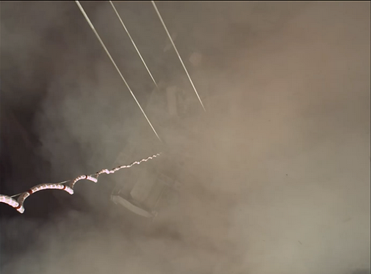
Motivation
When landing vehicles (rockets, planes, helicopters, etc) on the ground surface (of any planet), the exhaust can react violently with uncontrolled ground surfaces leading to:
Loss of visibility
Increased risk of damage to aircraft, mission critical instrumentation, etc.
Uneven landing surfaces (flow creates craters)
There is no effective method of modeling the problem experimentally. Because of this, the accuracy of CFD models on this subject is unknown. This project aims to fill that space in our understanding as well as provide more precise CFD models.
Safer landings for future vehicles on Earth and in space.
Prevent mission failures due to avoidable landing hazards.
Allow for more complex missions and landing sequences.
Provide data for CFD verification
Advance the technology in PSI studies by creating a physical apparatus that can be used in future studies by others
Notes:
Background and motivation: for example, when landing rockets on surface of planet, violent interaction, exhaust interacts with ground, particles kicked up and heated. Can cause damage to vehicle, also limits visibility. CFD models but limited experimental data (summary from report, will reword).
Understanding interactions = safer landings of spacecraft, aircraft (ex helicopters or planes)

Slide 4
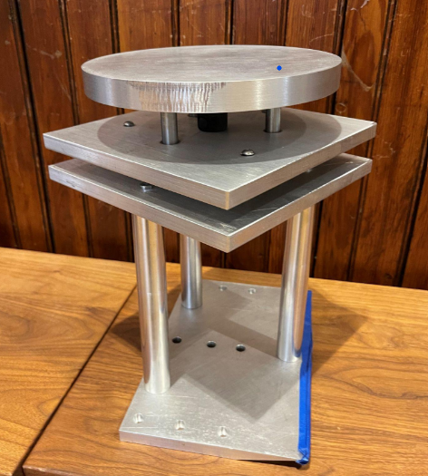
Problem Statement and Current Methods
Goal: To design an experimental setup to model sonic plumes at conditions similar to those on the Moon or Mars.
Previous Shortcomings/ targets for new design:
Data Acquisition
Integrated data collection system
Emphasis on accuracy
Plate Adjustment
Variable plate angle
Speed of adjustment during testing
Minimize opening/closing of shock tunnel
Remote control capabilities
Plate Stability
Reduce vibrations and improve consistency
Previous Team’s Plate Design

Slide 5
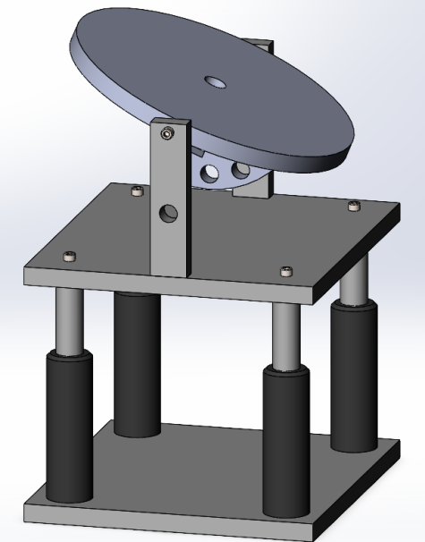
Concept Model Review: Concept 1
Manual angle setting with remote height variation
Utilizes a pin to mechanically lock the plate in position, while linear actuators can be used to adjust height.
Pro’s
Consistent, discrete angles
Design simplicity
Ease of height adjustment
IMU sensor not needed
Con’s
Angle must be changed manually

Slide 6
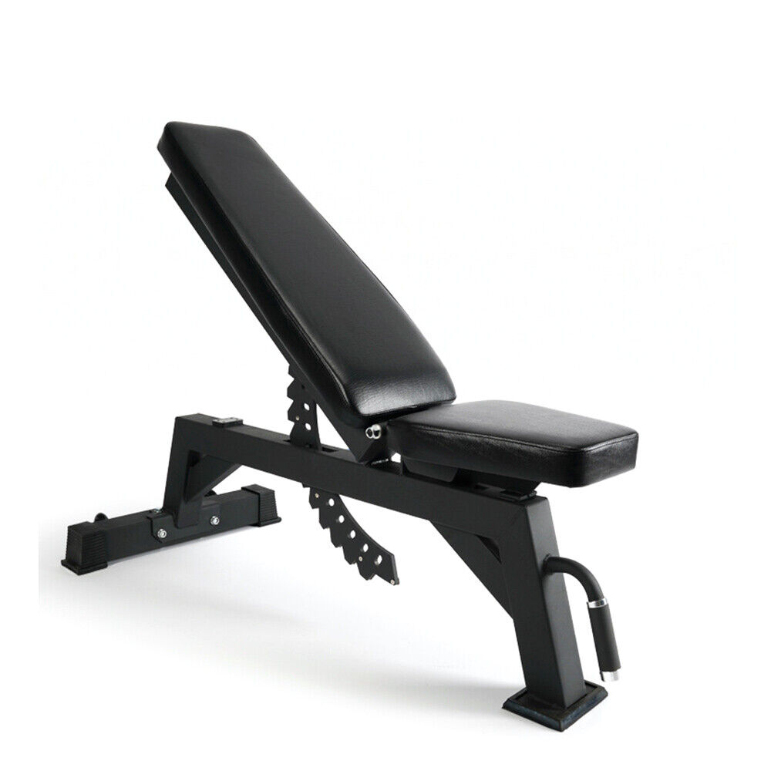
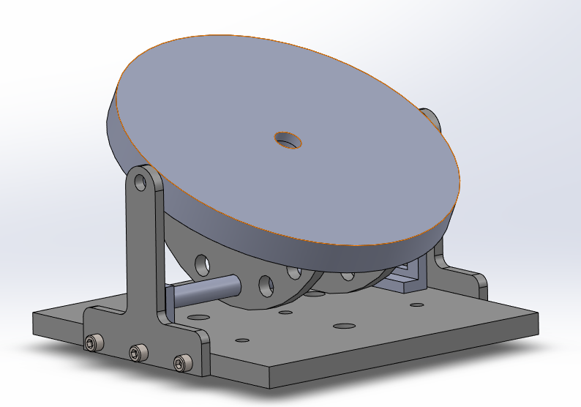
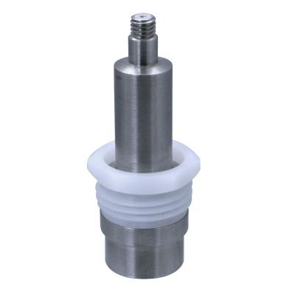
Structural System Prototype
The structural system is what allows for the angle of the plate to be changed in our design.
Derived from concept 1
4 distinct angle settings: 90°, 67.5°, 45°, 22.5°
Held in position by a pin, inspired by gym benches
Includes fittings for ICP Pressure Sensor

Slide 7
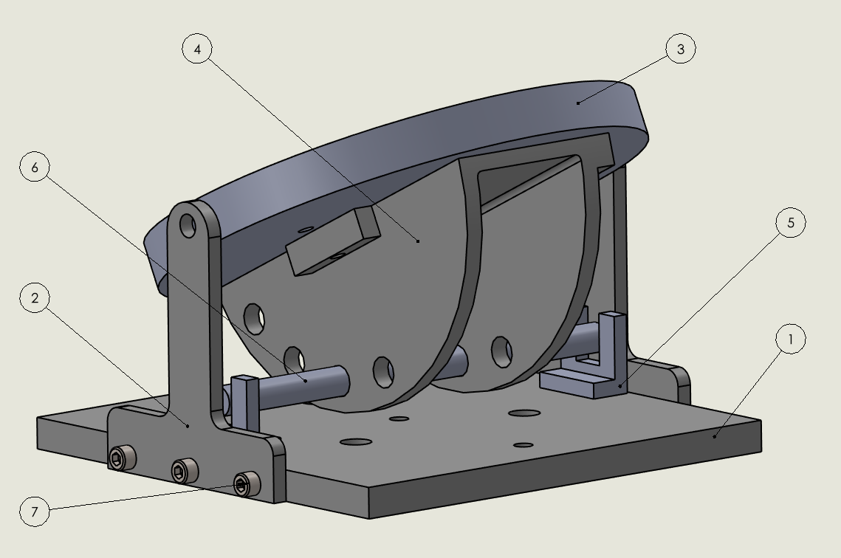
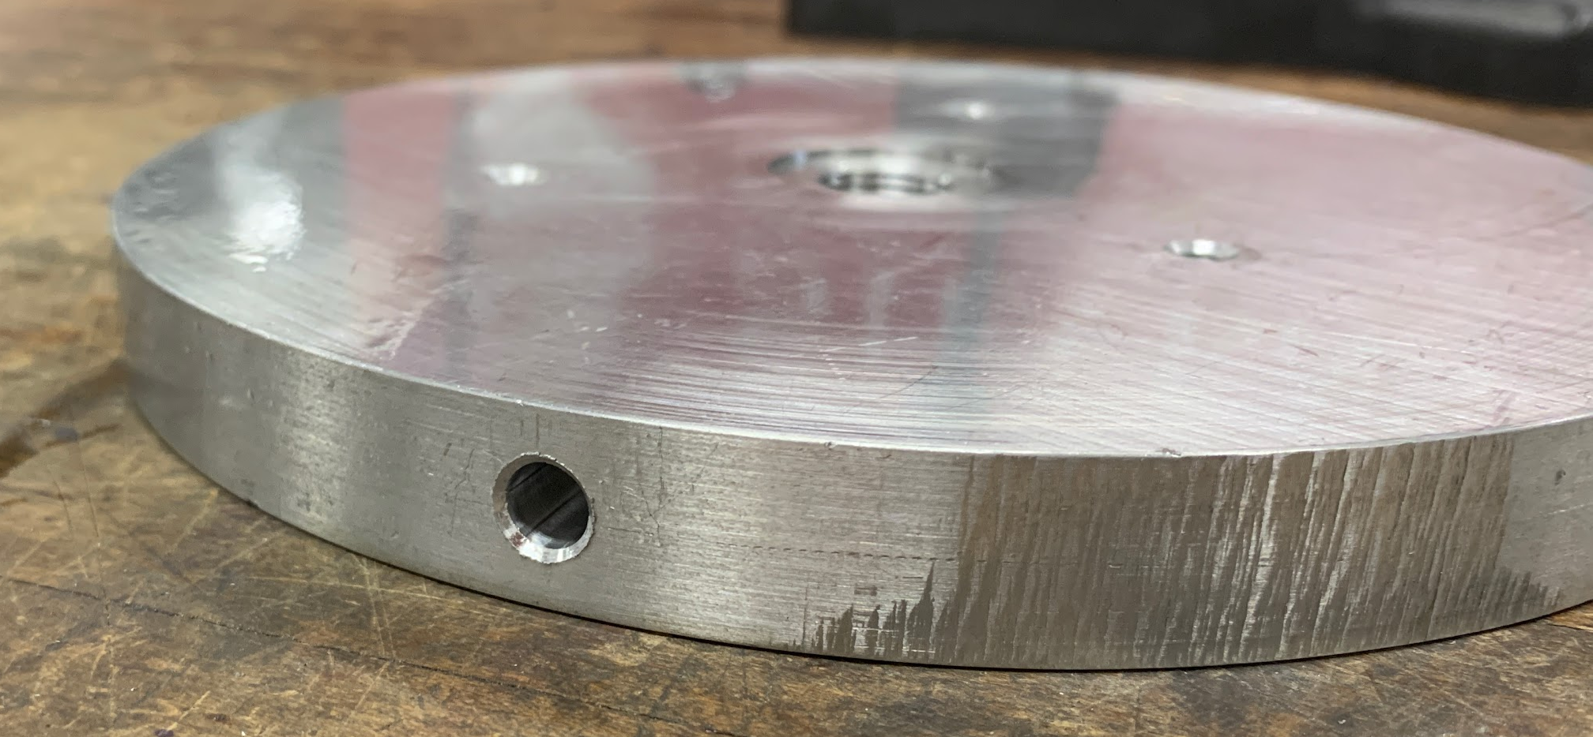
Construction of Alpha Prototype
Machining operations performed
Square Plate
  Received new mounting holes for plate supports
  ¼” 20 threaded
Impingement plate
  2 symmetric holes to allow for rotation about its center axis
  Center cutout based on mounting specifications of ICP sensor
3D printed Parts
(2) “T” support posts
(4) Angle Adjustment Mount
(5) pin locks

Slide 8
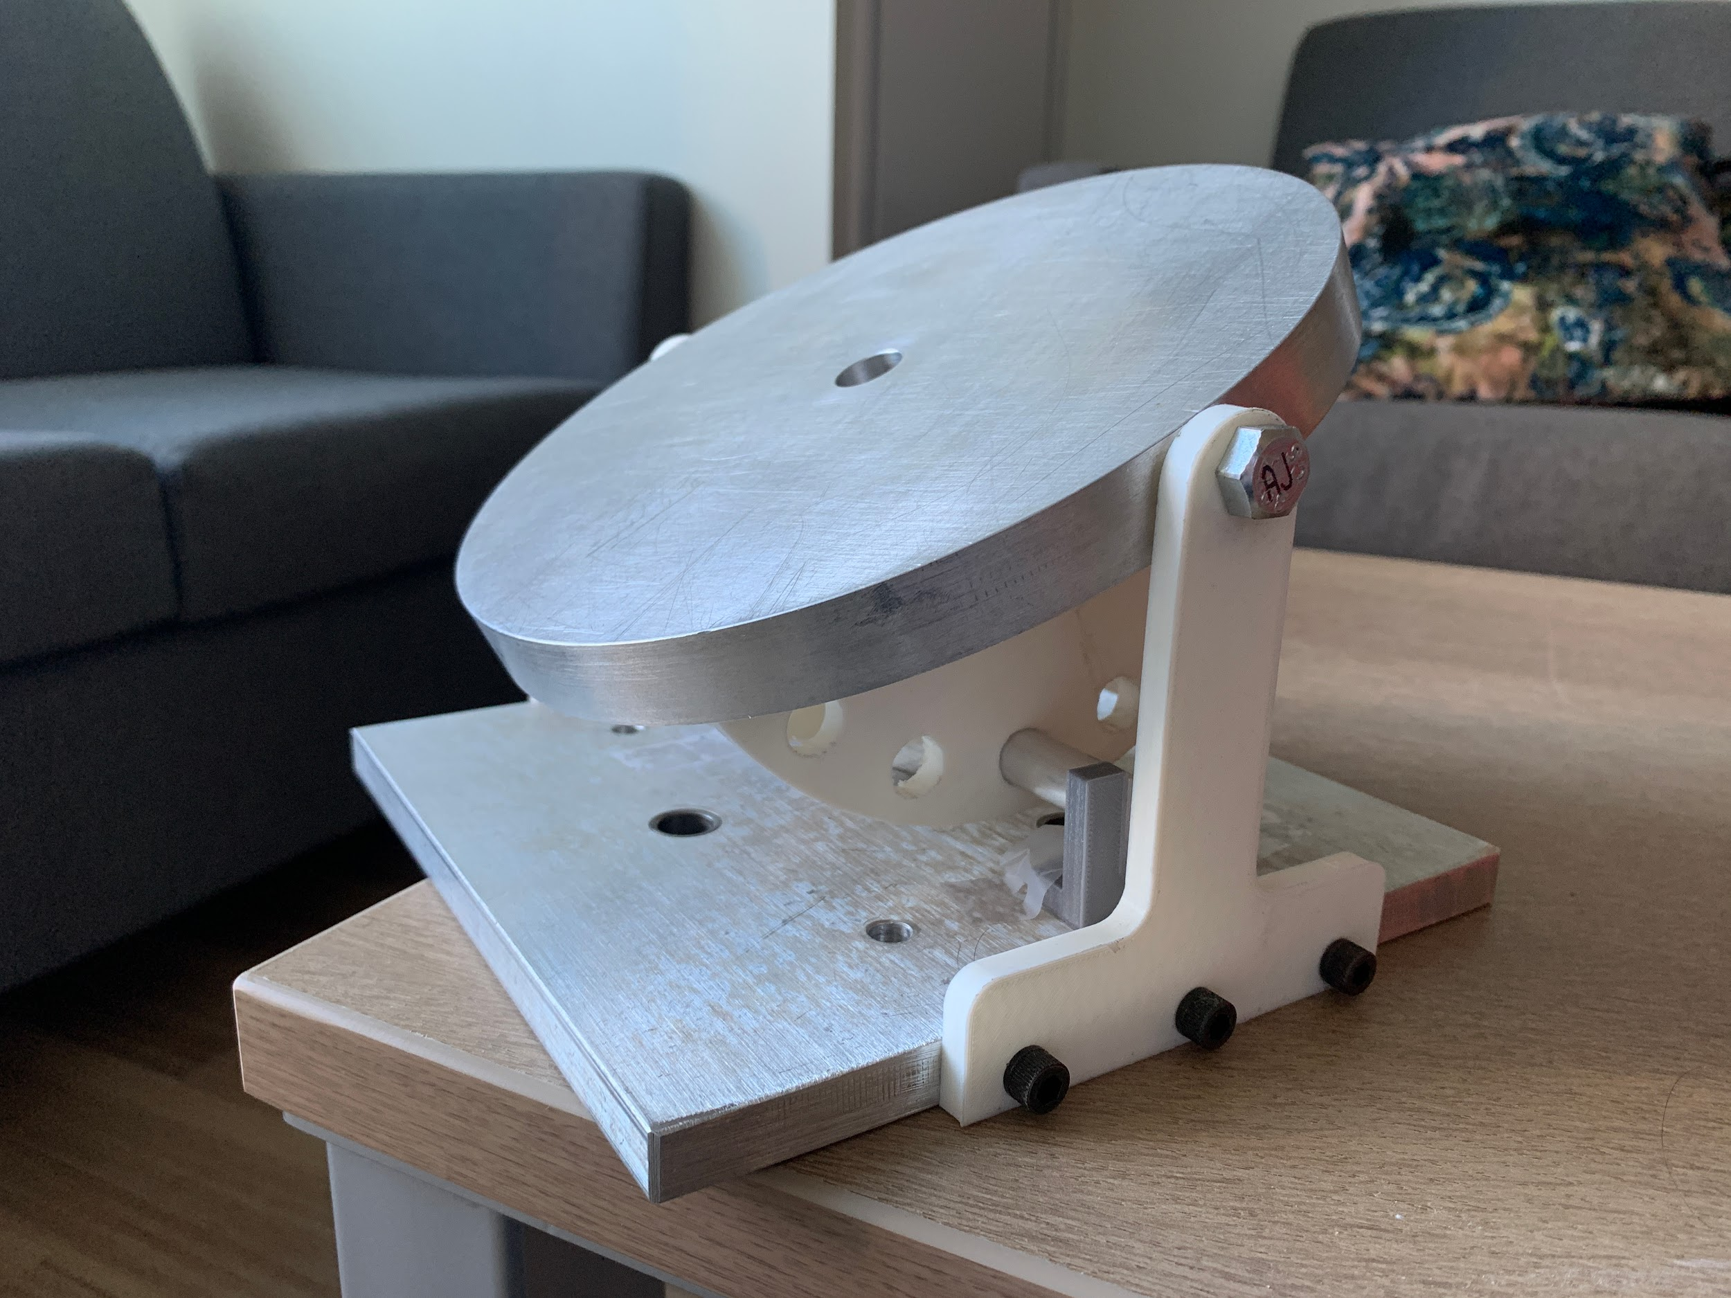
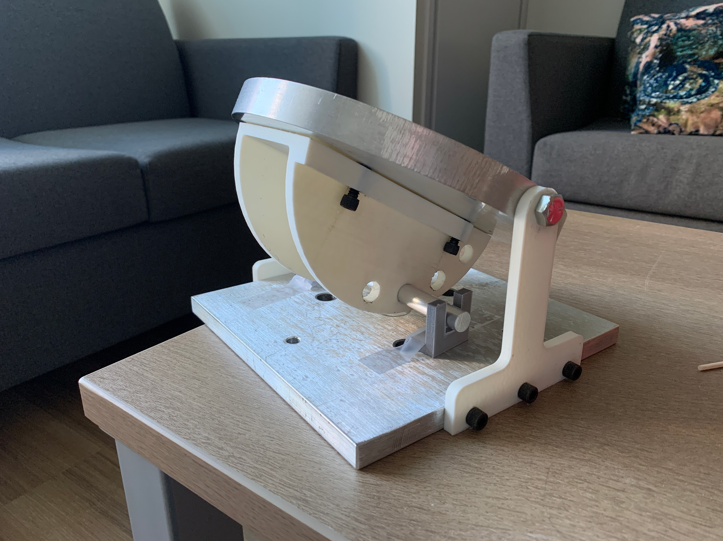
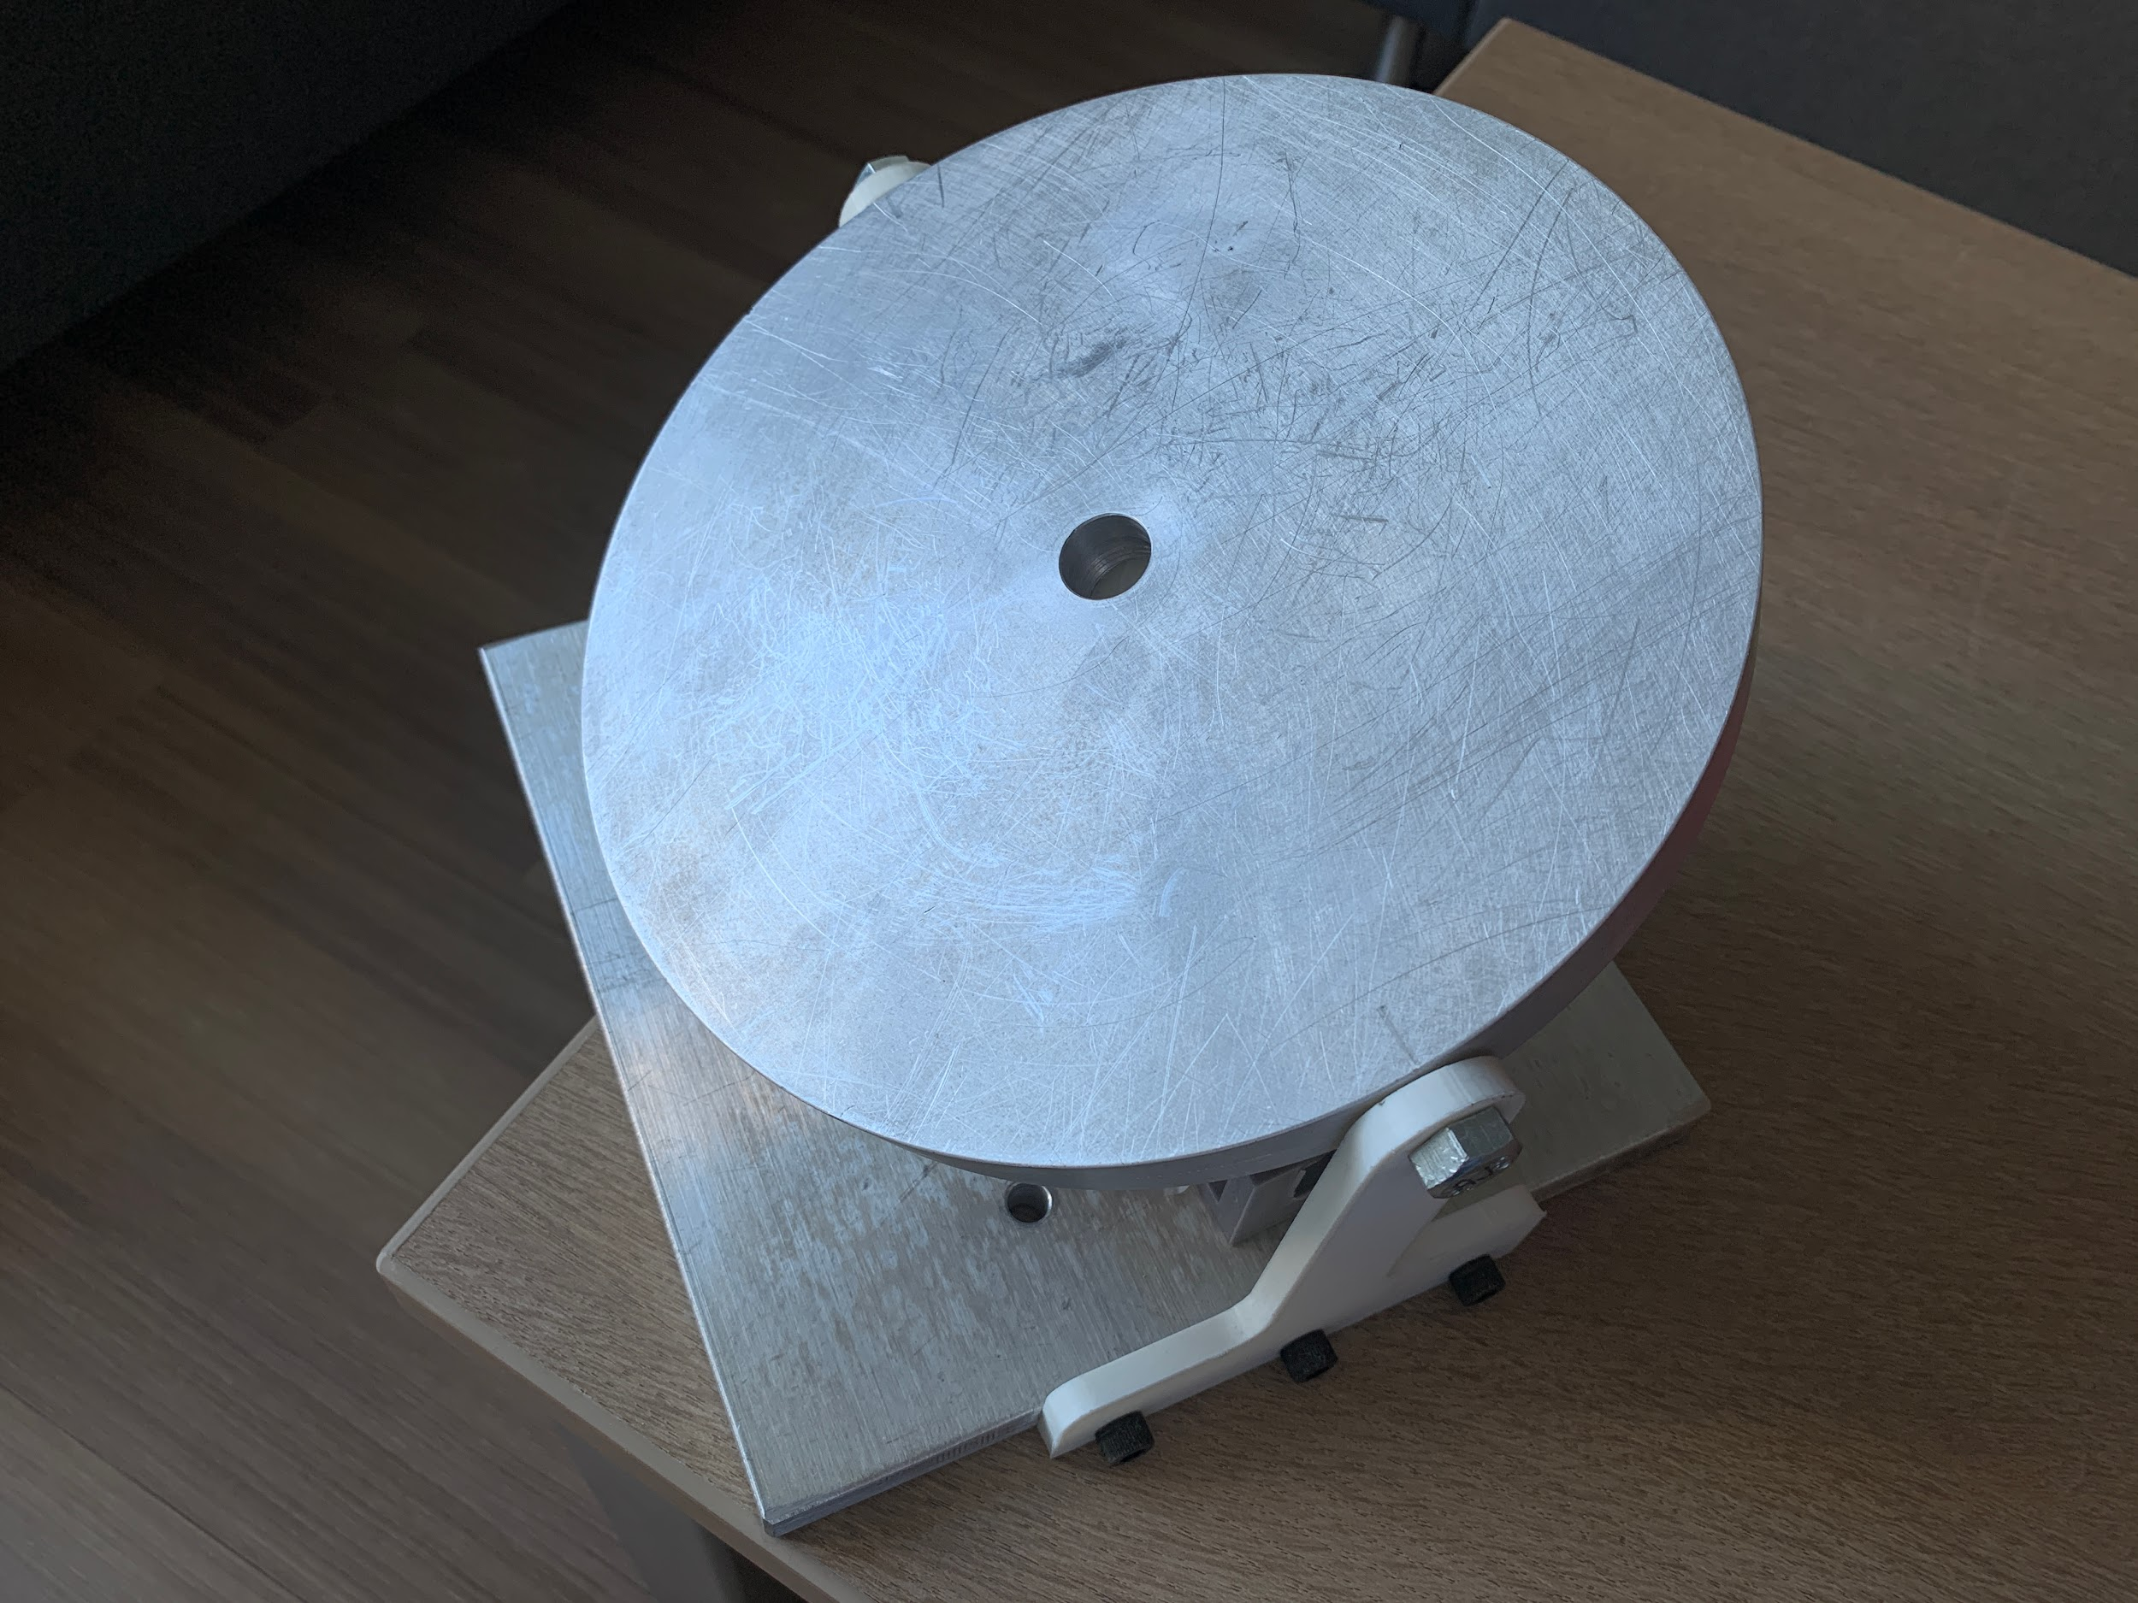
Assembled Alpha Prototype
Successfully allows for the plate to be rotated and held in position
Future Improvements:
Supports will be machined, not printed
Angle mount will be improved and reprinted
Stronger locking mechanism for the pin
Motor/gear assembly
Note: the alpha prototype cannot be tested in the tunnel at this time

Slide 9
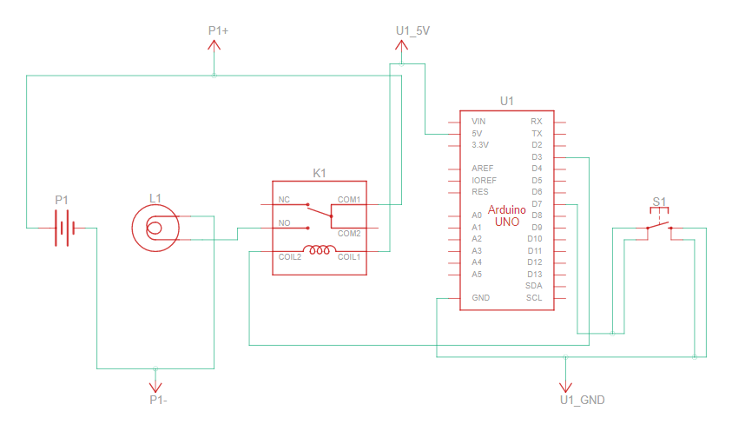
Electro-Pneumatic Prototype Schematic
Notable components:
  Arduino Uno
  SPDT Relay
  Granzow Solenoid
System runs on 110V AC
Button activates the relay
Once testing begins, the button will also activate a camera to take pictures

Slide 10

Electro-Pneumatic Prototype Demonstration

Slide 11
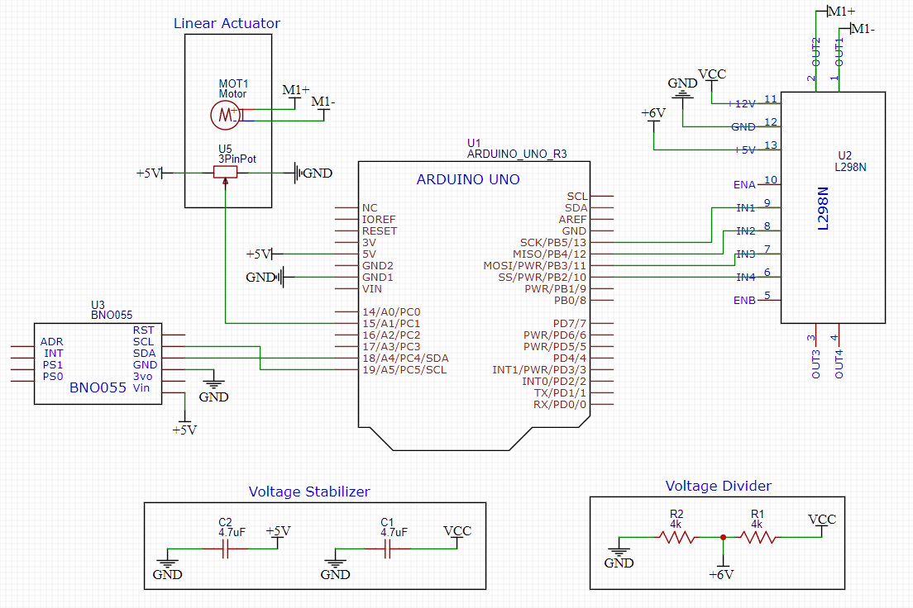
Electro-Mechanical Prototype Schematic
Notable components:
  Arduino Uno
  L298 H-Bridge Module
  BNO055 IMU Sensor
  Linear Actuator
System runs on 12V DC (VCC)
Arduino communicates to the computer via serial port
Computer gives end positions and arduino does all back end math/management

Slide 12
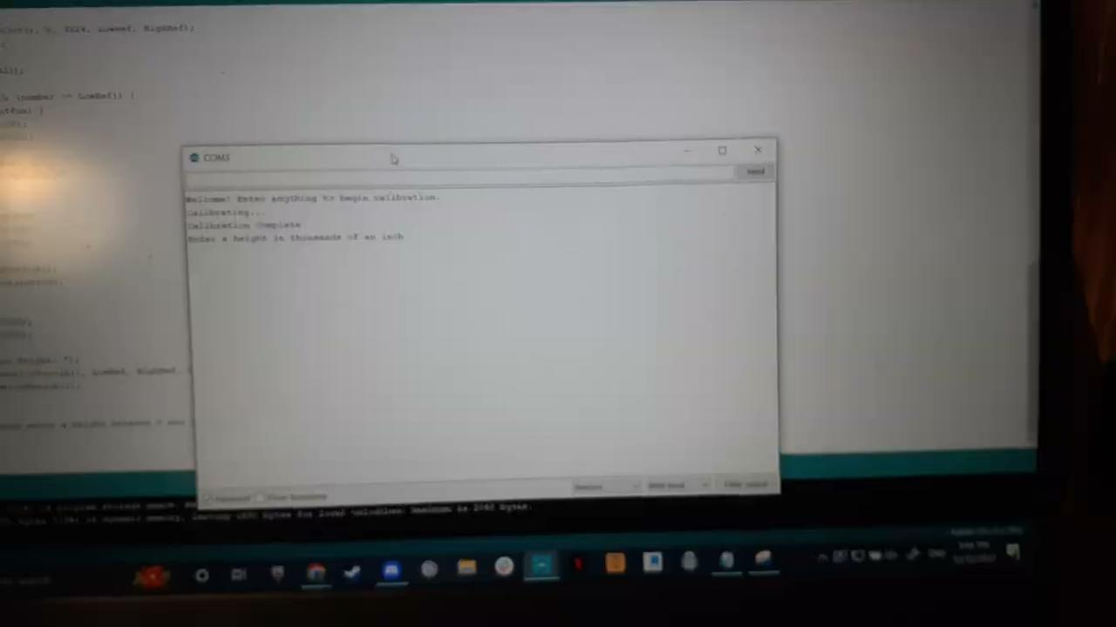
Electro-Mechanical Prototype Demonstration

Slide 13
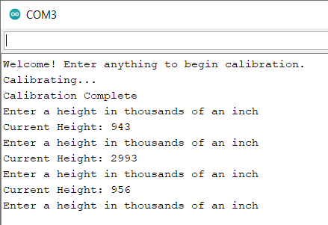
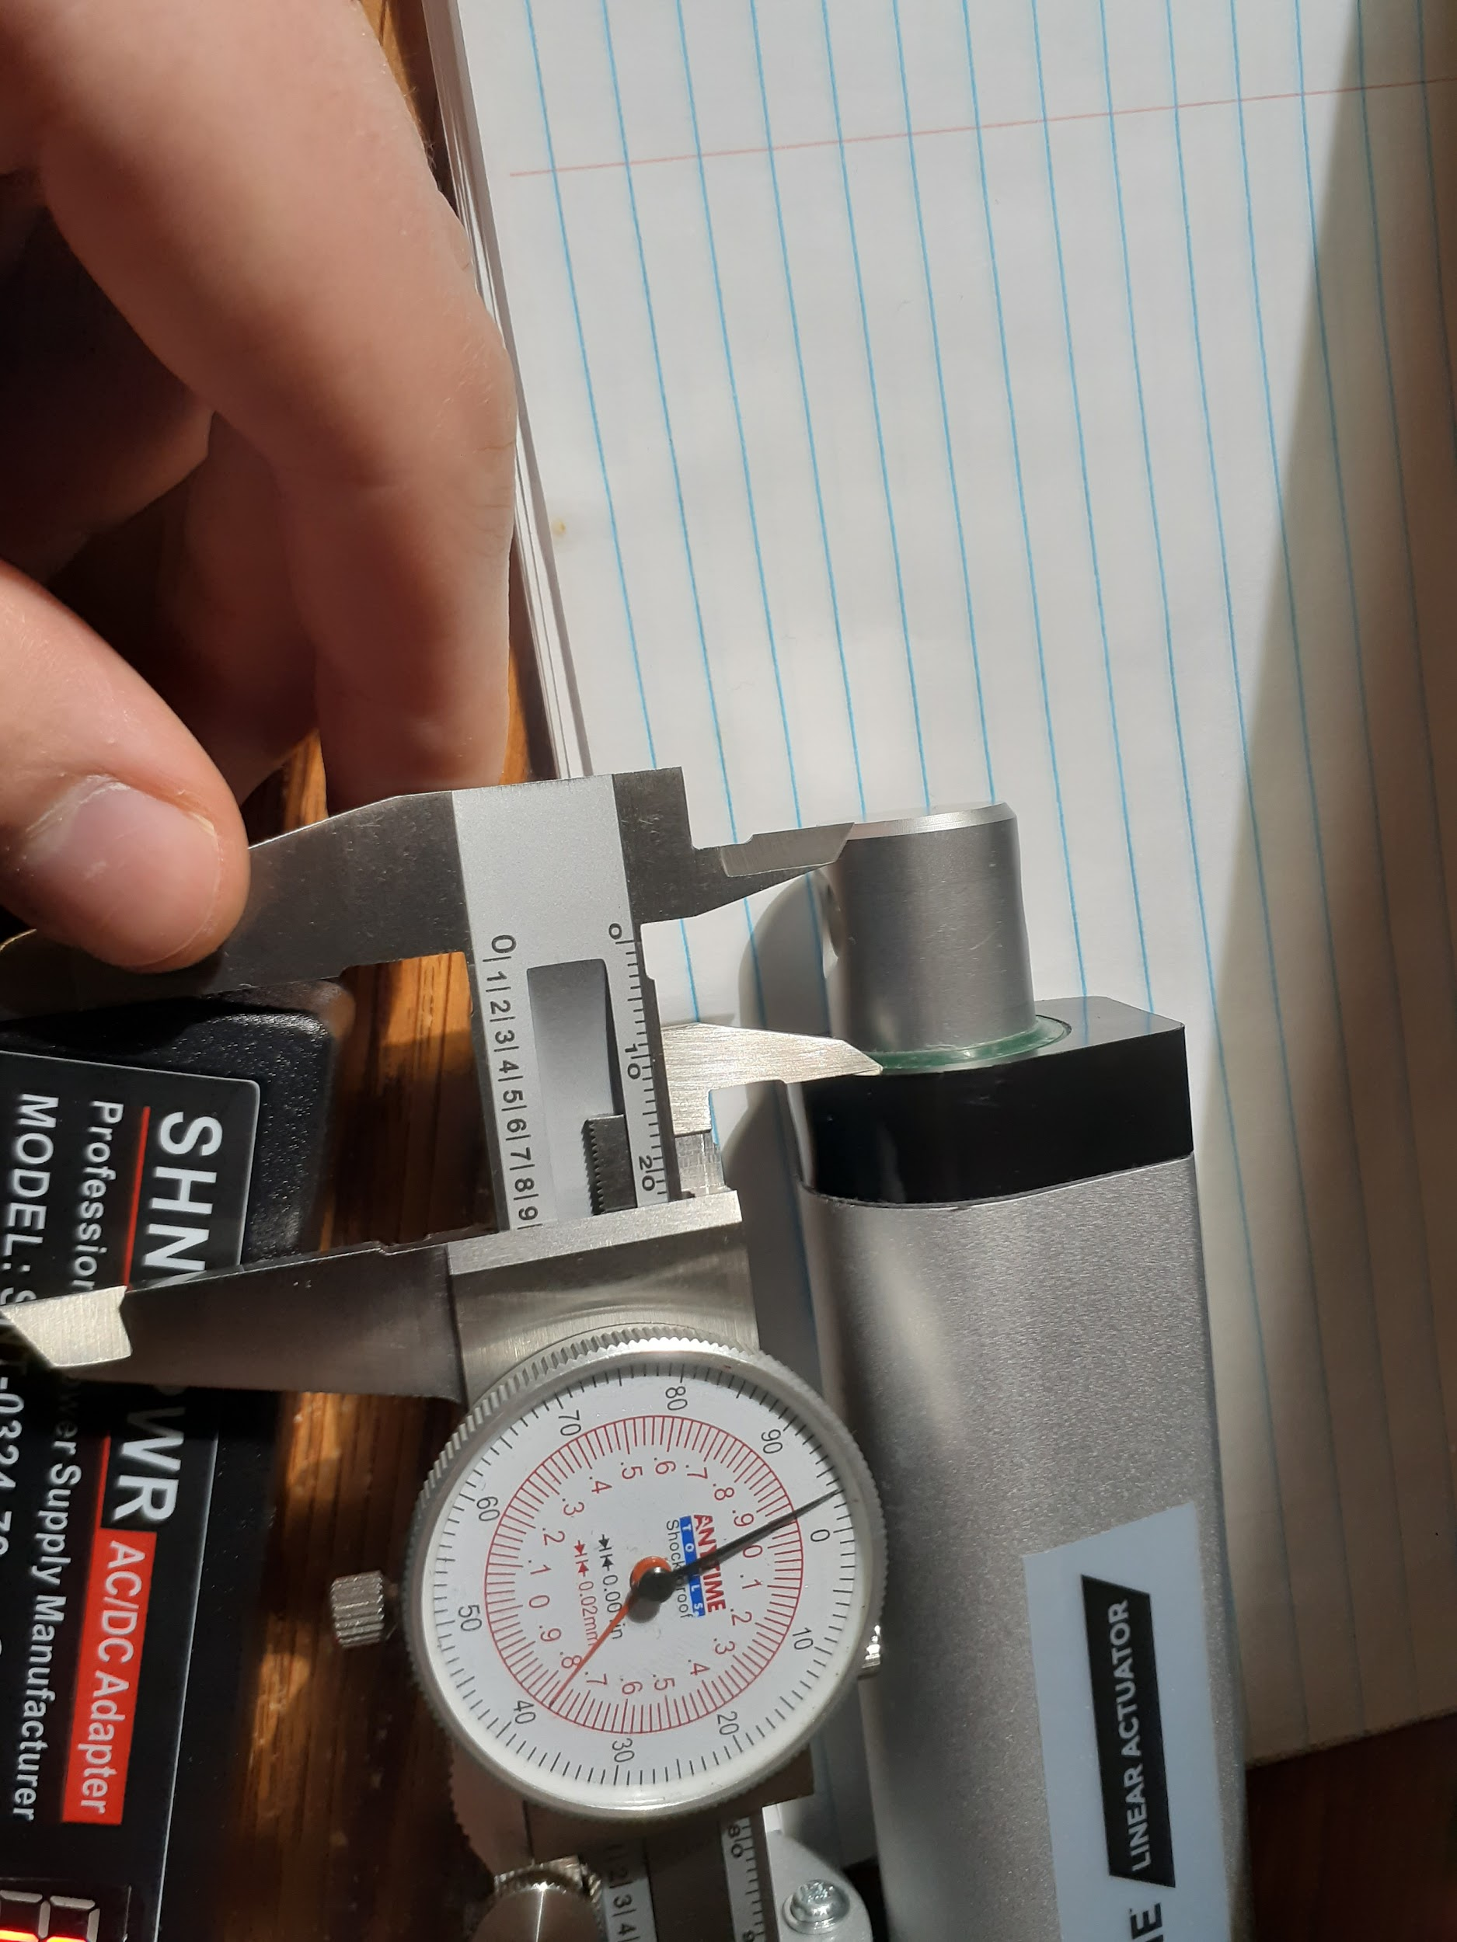
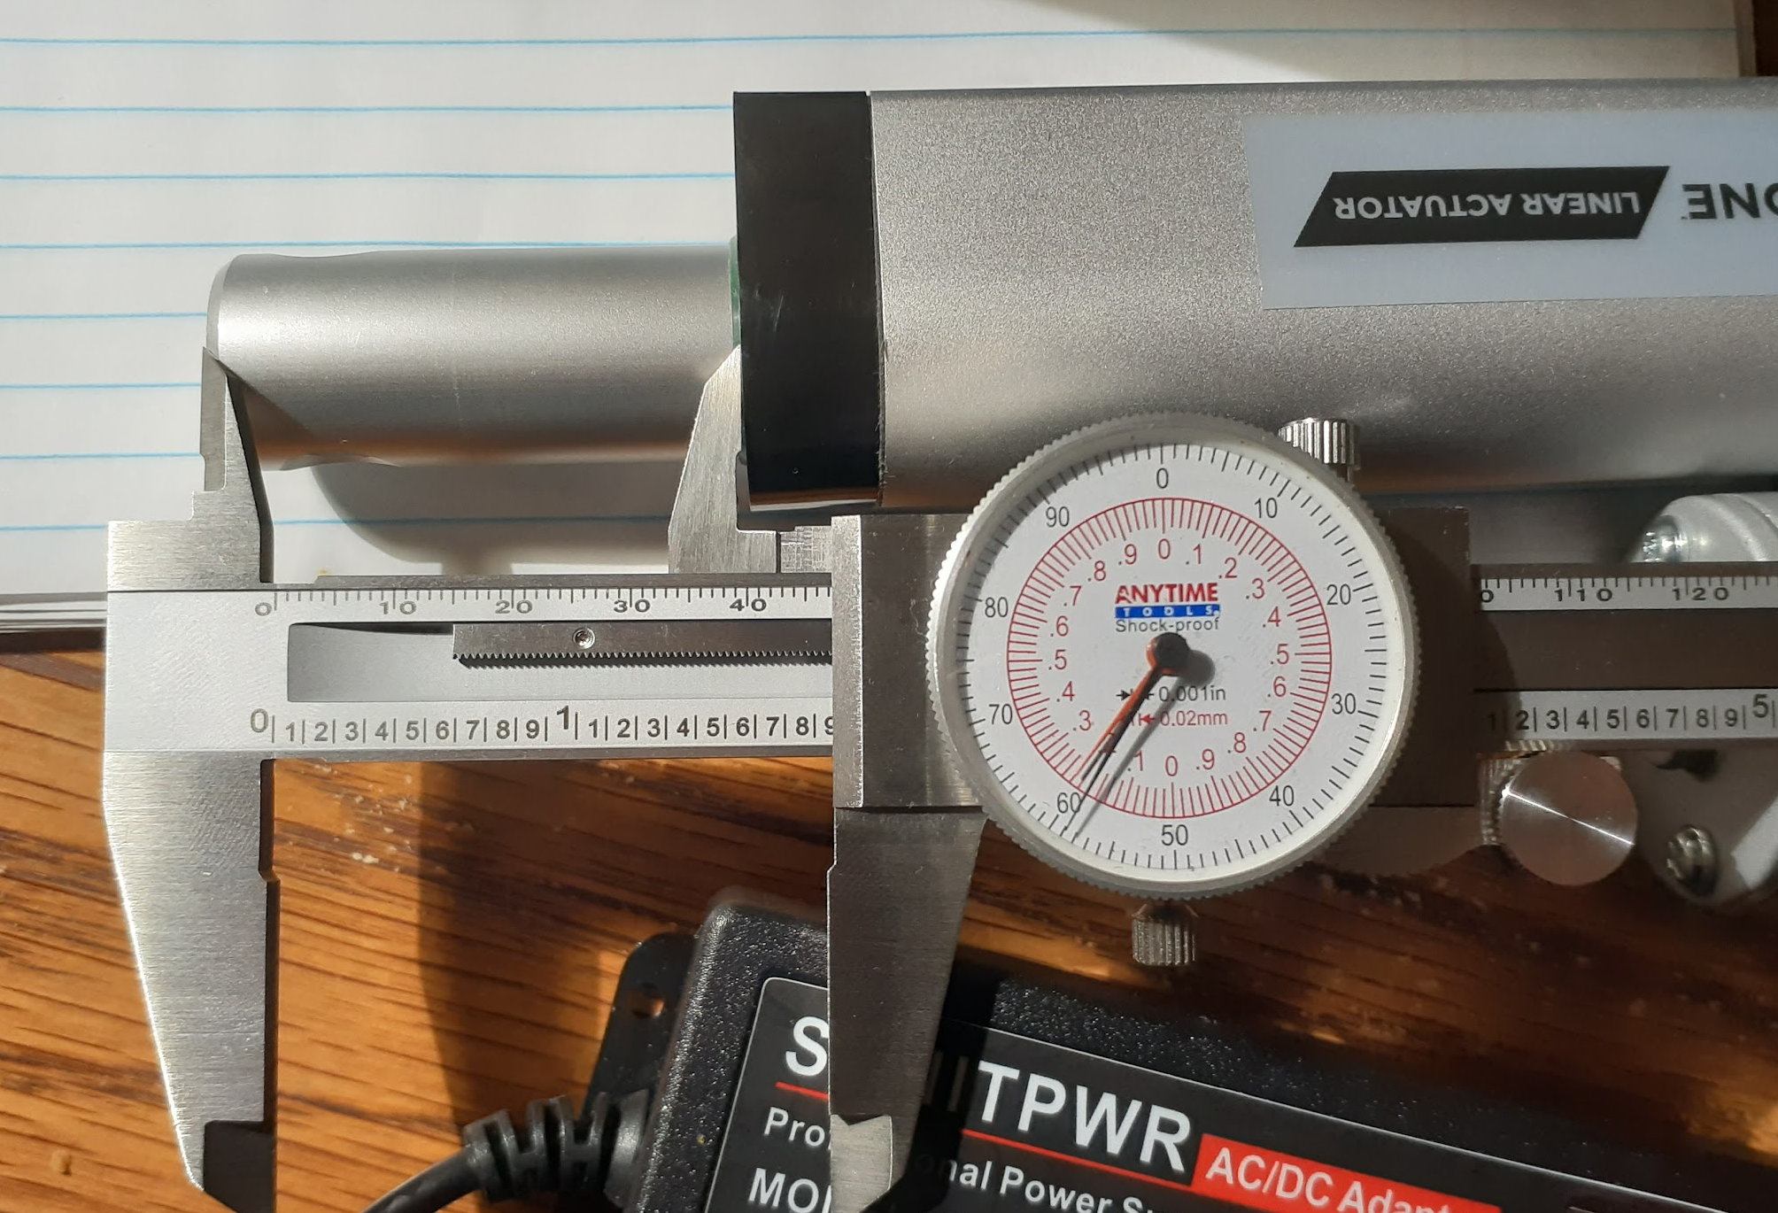
Electro-Mechanical Prototype Results
Input Sequence:
  1000
  3000
  1000
Output heights do not match input heights
Final output was measured to be 1.859in, or a height of 963
  Error of 0.007in or 0.72%
Acceptable error margins
**Measurement technique shown is not the technique used

Slide 14
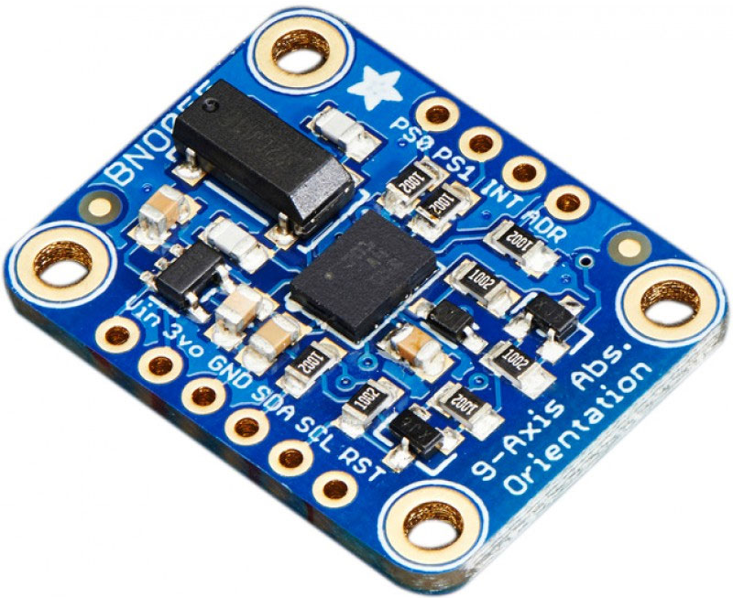
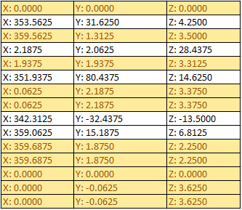
Electro-Mechanical Prototype Results
Listed are different orientations of the IMU Sensor
Y and Z values measure pitch and roll
Highlighted sections represent identical real world orientations
Y values experience errors of up to 2.250°
Z values experience errors of up to 3.625°
Errors exceed allowable margins

Slide 15

Project Plan
Immediate next step: incorporate linear actuator and electrical subsystem into mechanical system
Preliminary testing in shock tunnel
Proof of concept using Alpha prototype
Ensure the model is accessible through viewports
Allow for electric connections within the test section
Will require additional component design (actuator mount, custom PCB)
Address experimental problems as they arise (i.e. possible heating)
Collect and process data from single ICP pressure sensor
  Goal: prove data reliability to justify budget increases

Slide 16
QUESTIONS?

