Slide 1
Plume Surface Interactions on the Moon and Mars
Phase 2
Team members: Grant Brickner, Michael Burgos,
Jett Langhorn, Uesli Keta, Maria Ortiz
Project Advisors: Prof. Rabinovitch, Prof. Parziale

Slide 2
Overview
Phase 1 Summary
Motivation
Problem Statement and Current Methods
Phase 2
Concept Models
Technical Analysis
  Current Analysis
  Future Analysis
Component Specification
  Linear Actuators
  Sensors
Project Website
Next Steps
Questions and Answers

Slide 3
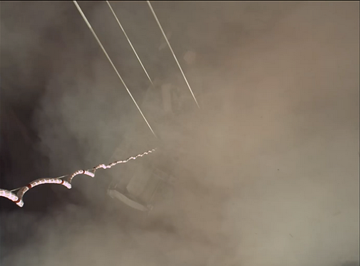
Motivation
When landing vehicles (rockets, planes, helicopters, etc) on the ground surface (of any planet), the exhaust can react violently with uncontrolled ground surfaces leading to:
Loss of visibility
Increased risk of damage to aircraft, mission critical instrumentation, etc.
Uneven landing surfaces (flow creates craters)
There is no effective method of modeling the problem experimentally. Because of this, the accuracy of CFD models on this subject is unknown. This project aims to fill that space in our understanding as well as provide more precise CFD models.
Safer landings for future vehicles on Earth and in space.
Prevent mission failures due to avoidable landing hazards.
Allow for more complex missions and landing sequences.
Notes:
Background and motivation: for example, when landing rockets on surface of planet, violent interaction, exhaust interacts with ground, particles kicked up and heated. Can cause damage to vehicle, also limits visibility. CFD models but limited experimental data (summary from report, will reword).
Understanding interactions = safer landings of spacecraft, aircraft (ex helicopters or planes)

Slide 4
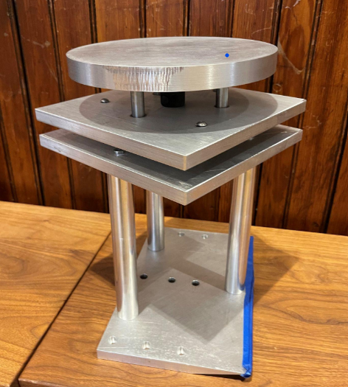
Problem Statement and Current Methods
Goal: To design an experimental setup to model sonic plumes at conditions similar to those on the Moon or Mars.
Previous Shortcomings/ targets for new design:
Data Acquisition
Integrated data collection system
Emphasis on accuracy
Plate Adjustment
Variable plate angle
Speed of adjustment during testing
Minimize opening/closing of shock tunnel
Remote control capabilities
Plate Stability
Reduce vibrations and improve consistency
Previous Team’s Plate Design

Slide 5
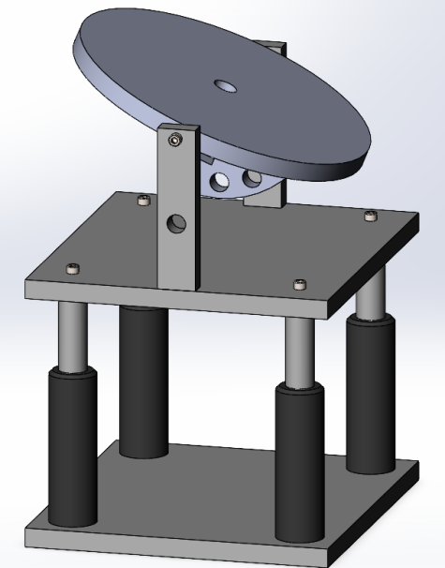
Phase 2: Concept 1
Manual angle setting with remote height variation
Utilizes a pin to mechanically lock the plate in position, while linear actuators can be used to adjust height.
Pro’s
Consistent, discrete angles
Design simplicity
Ease of height adjustment
IMU sensor not needed
Con’s
Angle must be changed manually

Slide 6
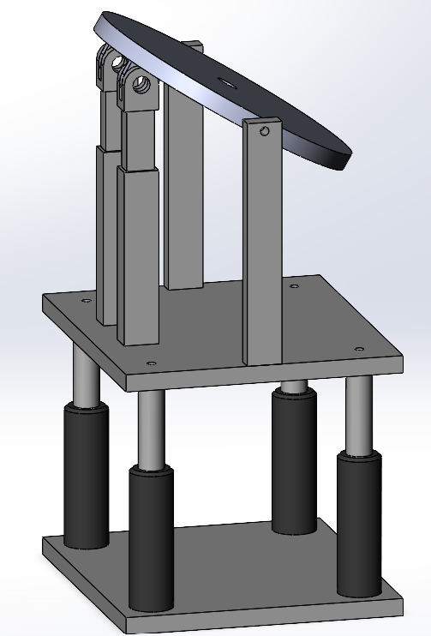
Phase 2: Concept 2
Actuating angle setting and height variation
Utilizes one set of linear actuators to adjust angle and another set for height adjustment
Pro’s
Ease of height/angle adjustment
Con’s
Requires additional components
Potential loss of consistency/accuracy

Slide 7
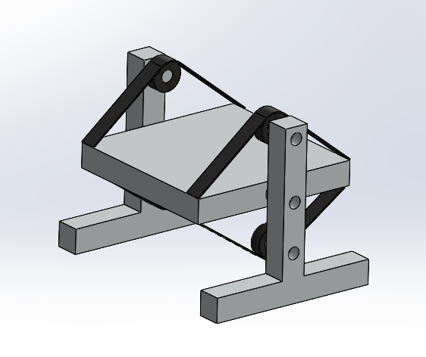
Phase 2: Concept 3
Remote angle variation
Utilizes belts and motors to move the angle of
the plate
Pro’s
Precision angle movement
Remote angle movement
Con’s
Angle cannot be easily measure
Potential loss of accuracy
Height cannot be changed

Slide 8
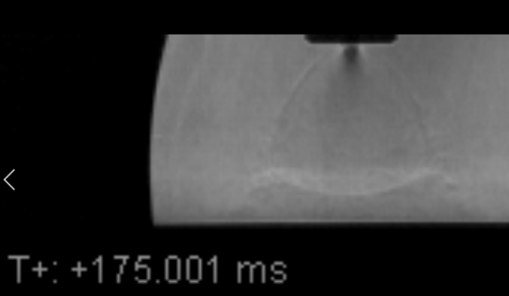
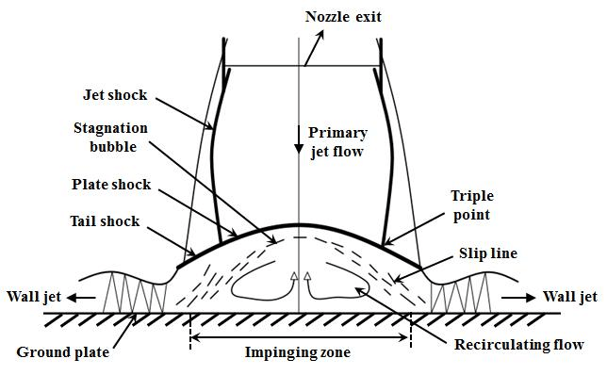
Technical Analysis - Current Overview
Focused on determining the vertical force present at the plate
  Knowing the vertical forces will allow us to better understand the required component specs
Results and theory validation will be derived from previous experimental results
Initial Assumptions:
  Test section will exist at vacuum
  Primary jet flow will be bounded by the apparent shock
  Flow expands isentropically in test section
  Flow stagnates completely in the Impinging zone
  Specific heat ratio is independent of temperature
  Reservoir is very large

Slide 9
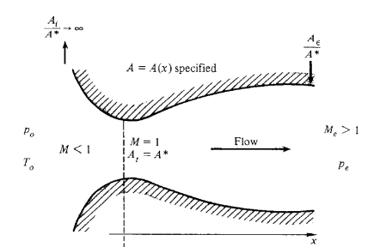
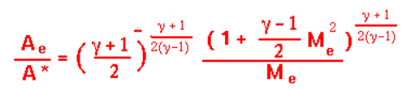
Technical Analysis - Isentropic Expansion
As the gas enters the vacuum, it expands and speeds up
The apparent shock defines the geometry of the flow in the same way a rocket nozzle defines the flow
Assuming isentropic expansion, we can determine the speed of the gas before it makes contact with the plate
By counting pixels, the exit area can be determined
Using the relation shown below, the Mach number can be calculated as a function of the specific heat ratio and the area ratio
143pxl (1.25in)
137pxl (1.198in)

Slide 10

Technical Analysis - Pressure Loss
Shock waves are highly entropic phenomena
  This entropy is expressed as a loss in pressure
Assume the reservoir static pressure is equal to the reservoir stagnation pressure
Since mach number was previously calculated, stagnation pressure on the plate can be calculated using the normal shock relation shown
  Note the stagnation pressure is proportional to the reservoir pressure

Slide 11
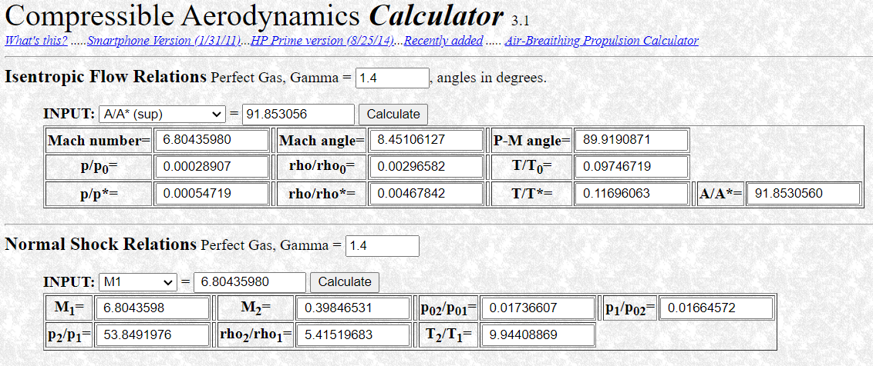
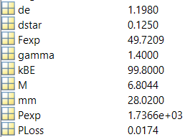
Technical Analysis - MATLAB Script
Formulas were implemented into a MATLAB script and results were compared to the VA Tech Online Compressible Aerodynamics Calculator
Model has been validated
Results for the given experimental test are shown below
Expected force is nearly 50N

Slide 12
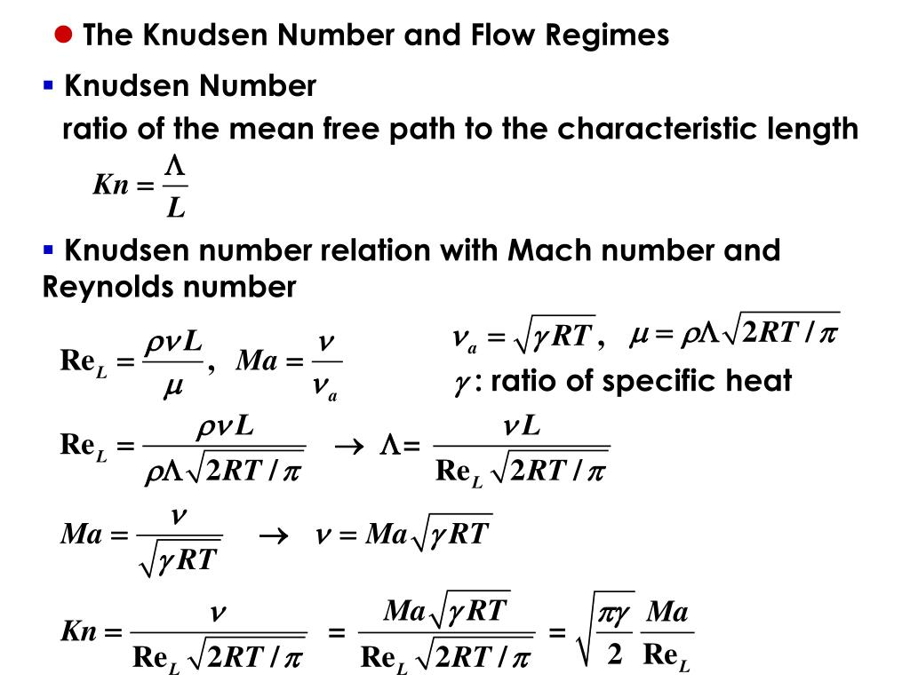

Technical Analysis - Future Analysis
Reynolds Number
  A ratio of inertial to viscous forces
  Used to check dynamic similarity between different tests
Knudsen Number
  A ratio of the mean free path to the characteristic length
  A function of Reynolds Number, used to validate continuity assumptions
Testing Time
  Dependent on mass flow rate as well as total volume of test section

Slide 13
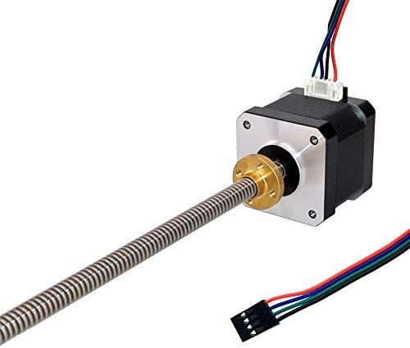
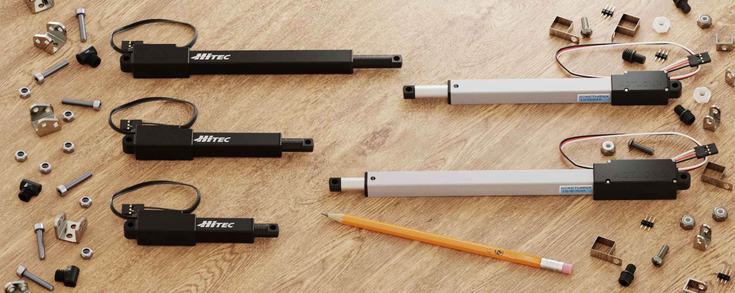
Technical Analysis - Component Verification
Purpose: Actuate the plate assembly
Handle load of 50N from fluid flow + ~33N from plate assembly weight
Cost vs Power Consideration
  Stepper motor linear actuator ($28.78)
    Based off of provided holding torque specifications, at max height of 1.25in, max load = 13.22N
      Need at least 7 (not considering any factor of safety)
    More discrete motion, better distance (height) control
  Linear Servo ($99)
    Max thrust capability of 48.9lbs (217.51N) each
    2-3 needed for plate stability/angle adjustment
    Sensitive to vibrations

Slide 14
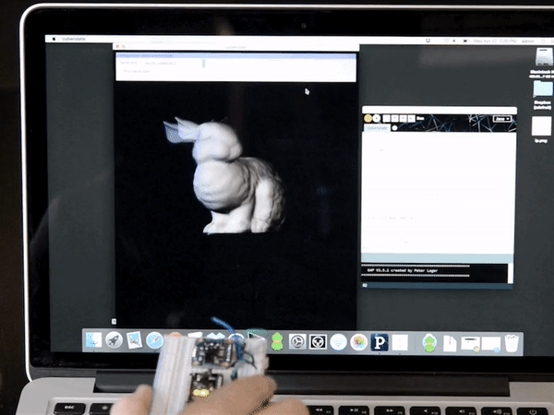
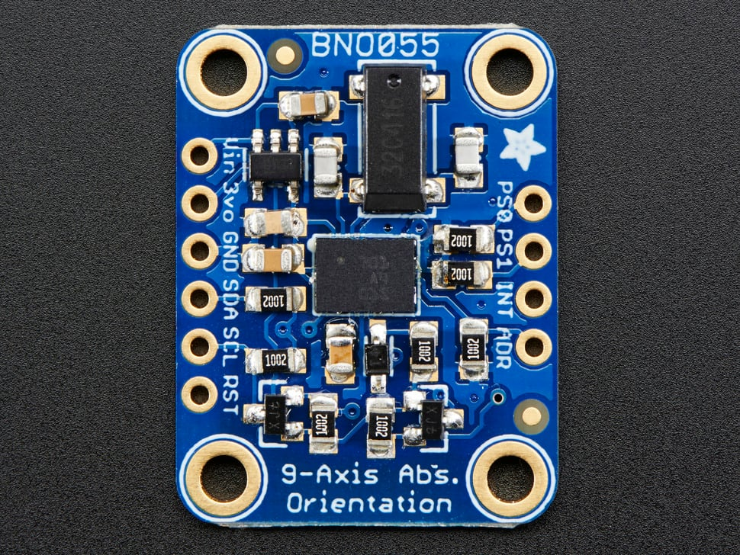
Technical Analysis - Absolute Orientation IMU Sensor
Purpose: Verify the plate angle
Senses orientation with respect to the force of gravity
Precisely measure the angle of the plate
  1/16° accuracy
Initial Proposition: Use 2
  Mechanically fix nozzle instead and use 1
Pros:
  Cheap
  Great for remote angle adjustment/verification (Concept 2)
Cons:
  Need to verify level of accuracy
  Pin availability on Arduino
  Potential for accuracy drift

Slide 15
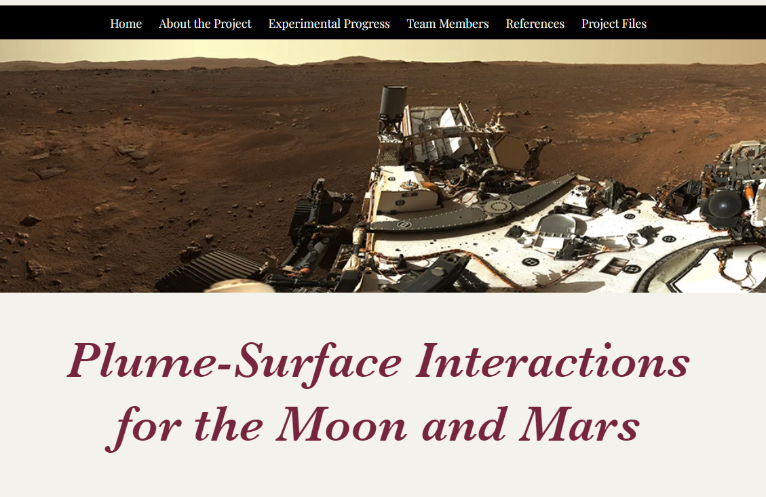
Project Website - Overview
Includes general overviews of each project section
  Background information
  Design concept selection process
  Technical analysis
  Future steps to be taken
Will be updated continuously
Website: HERE

Slide 16

Next Steps
Currently limited to one pressure transducer
Consider implementing a regulator to set the reservoir pressure, control mass flow rate
  Lowering reservoir → lower the stagnation pressure → reduce vibrations on the plate
    Design consideration for the actuators
Obtain data with one transducer, show significant results, budget for more
Notes:
We want the transducers to expand radially out from the center of the plate to get a better pressure map over the plate, ideally like 3 of the sensors in a line with one of them being in the center of the plate. In regards to the “design considerations for the actuators” part, thats just in reference to the fact that electric linear actuators tend to struggle with vibrations

Slide 17
QUESTIONS?

