Slide 1
Plume Surface Interactions on the Moon and Mars
Phase 4
Team members: Grant Brickner, Michael Burgos,
Jett Langhorn, Uesli Keta, Maria Ortiz
Project Advisors: Prof. Rabinovitch, Prof. Parziale

Slide 2
Overview
Motivation
Phase I-III Summary
Current Goals and Objectives
Project deliverables
Alpha Prototype
  Testing
  Experimental Setup
  Results and Analysis
  Conclusions
Beta Prototype
  Current Design
  Noteworthy Improvements
  Future Plans
Updated Timeline
Bill of Materials

Slide 3
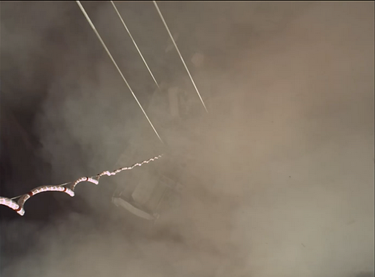
Motivation
When landing vehicles (rockets, planes, helicopters, etc) on the ground surface (of any planet), the exhaust can react violently with uncontrolled ground surfaces leading to:
Loss of visibility
Increased risk of damage to aircraft, mission critical instrumentation, etc.
Uneven landing surfaces (flow creates craters)
There is no effective method of modeling the problem experimentally. Because of this, the accuracy of CFD models on this subject is unknown. This project aims to fill that space in our understanding as well as provide more precise CFD models.
Safer landings for future vehicles on Earth and in space.
Prevent mission failures due to avoidable landing hazards.
Allow for more complex missions and landing sequences.
Provide data for CFD verification
Advance the technology in PSI studies by creating a physical apparatus that can be used in future studies by others
Notes:
Background and motivation: for example, when landing rockets on surface of planet, violent interaction, exhaust interacts with ground, particles kicked up and heated. Can cause damage to vehicle, also limits visibility. CFD models but limited experimental data (summary from report, will reword).
Understanding interactions = safer landings of spacecraft, aircraft (ex helicopters or planes)

Slide 4
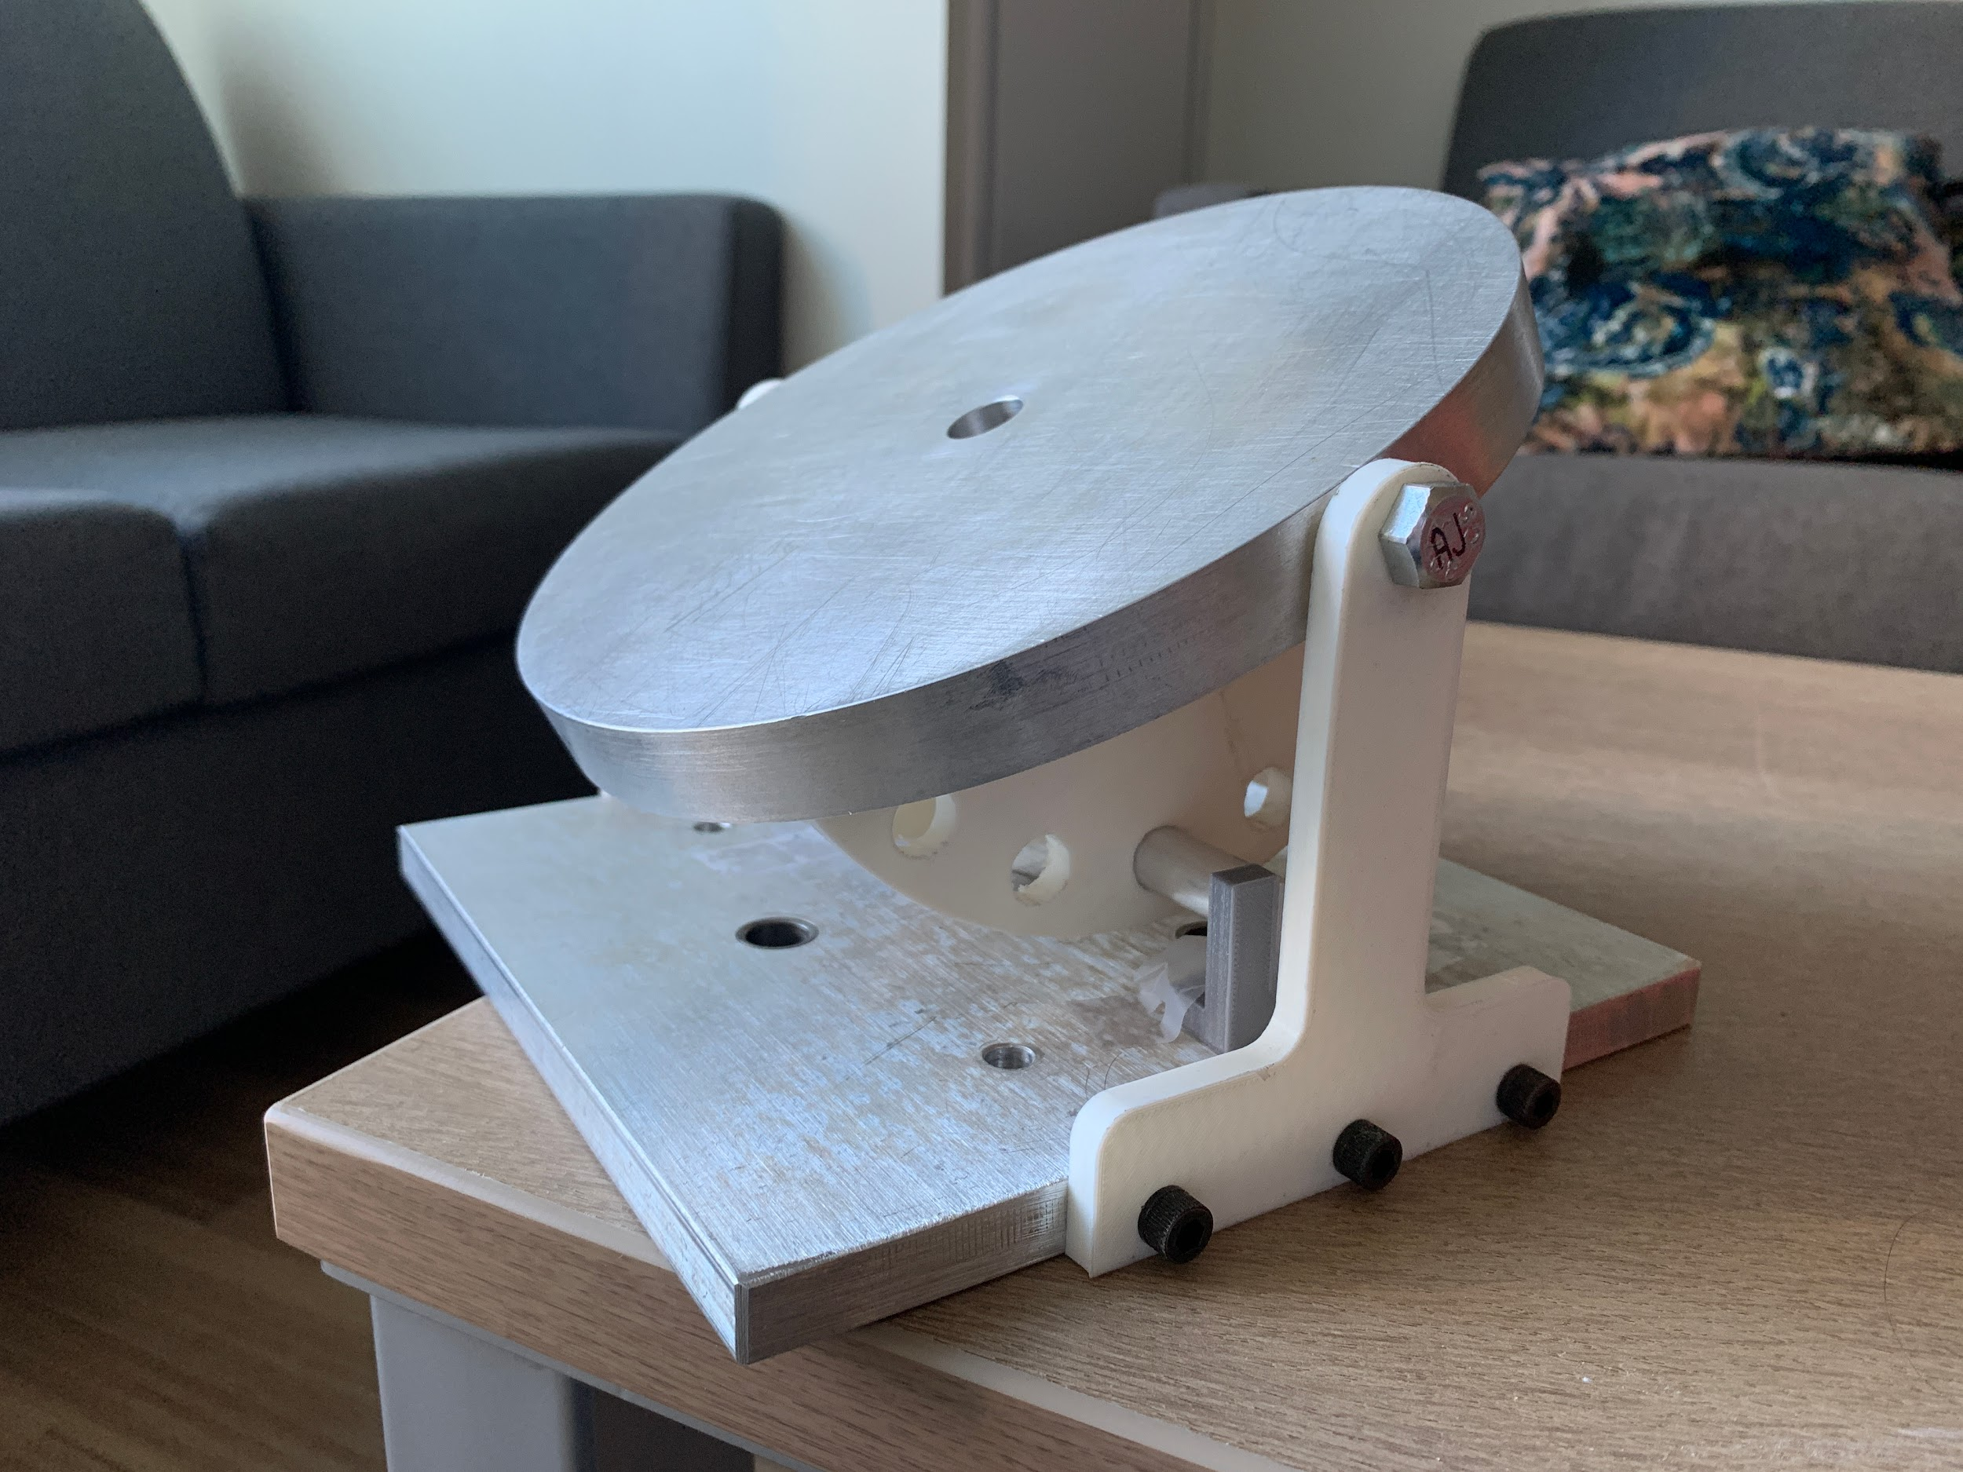
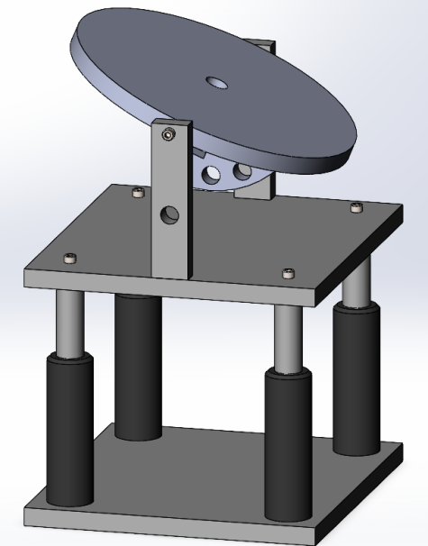
Phase I-III Recap
Assembly:
Remote linear actuator and manual angle adjuster
Due to issues, had to change to remote stepper motor
T-brackets need to be redesigned to be able to hold the pin for the angle adjustment
Pneumatic:
Consists of solenoid, camera, and pressure sensor
All need to be activated at the same time
Electromechanical:
Linear actuator: small percent error but was too large to fit into the testing section
IMU Sensor: Not accurate and the same results could not be achieved twice
Stepper Motor: Slower and requires more complicated build. More accurate, cheaper, more compact

Slide 5
Goals and Objectives
Completion of Alpha Prototype
  Incorporate all subsystems into design
  Test functionality of stepper motor with plate design and angle adjustment system
Preliminary ambient testing with Alpha Prototype
  Test pressure sensor capabilities to provide accurate data
  Proof of concept moving into Beta Prototype production
Development of data acquisition and processing methods
  Initial testing of these methods alongside ambient testing
Begin testing in shock tunnel
  Dependent upon shock tunnel availability
  Ensure model compatibility with shock tunnel space available
  Test design functionality under vacuum conditions

Slide 6
Project Deliverables
Initial testing plan
  Conducted testing on the alpha prototype to assess its performance and to identify any design issues that need to be addressed
  Begin to define the test objectives, test environment, test equipment, and test procedures
Preliminary ambient testing
  Collected data on the performance of the sensors and analyzed it to identify any potential issues or areas for improvement
  Developed MATLAB data processing method for this purpose
  Test results
Alpha Prototype modifications for Beta Prototype
  Beginning Beta Prototype production
  Based upon initial testing results and modification requirements
Collection of Experimental data inside shock tunnel
  Data collection and analysis

Slide 7
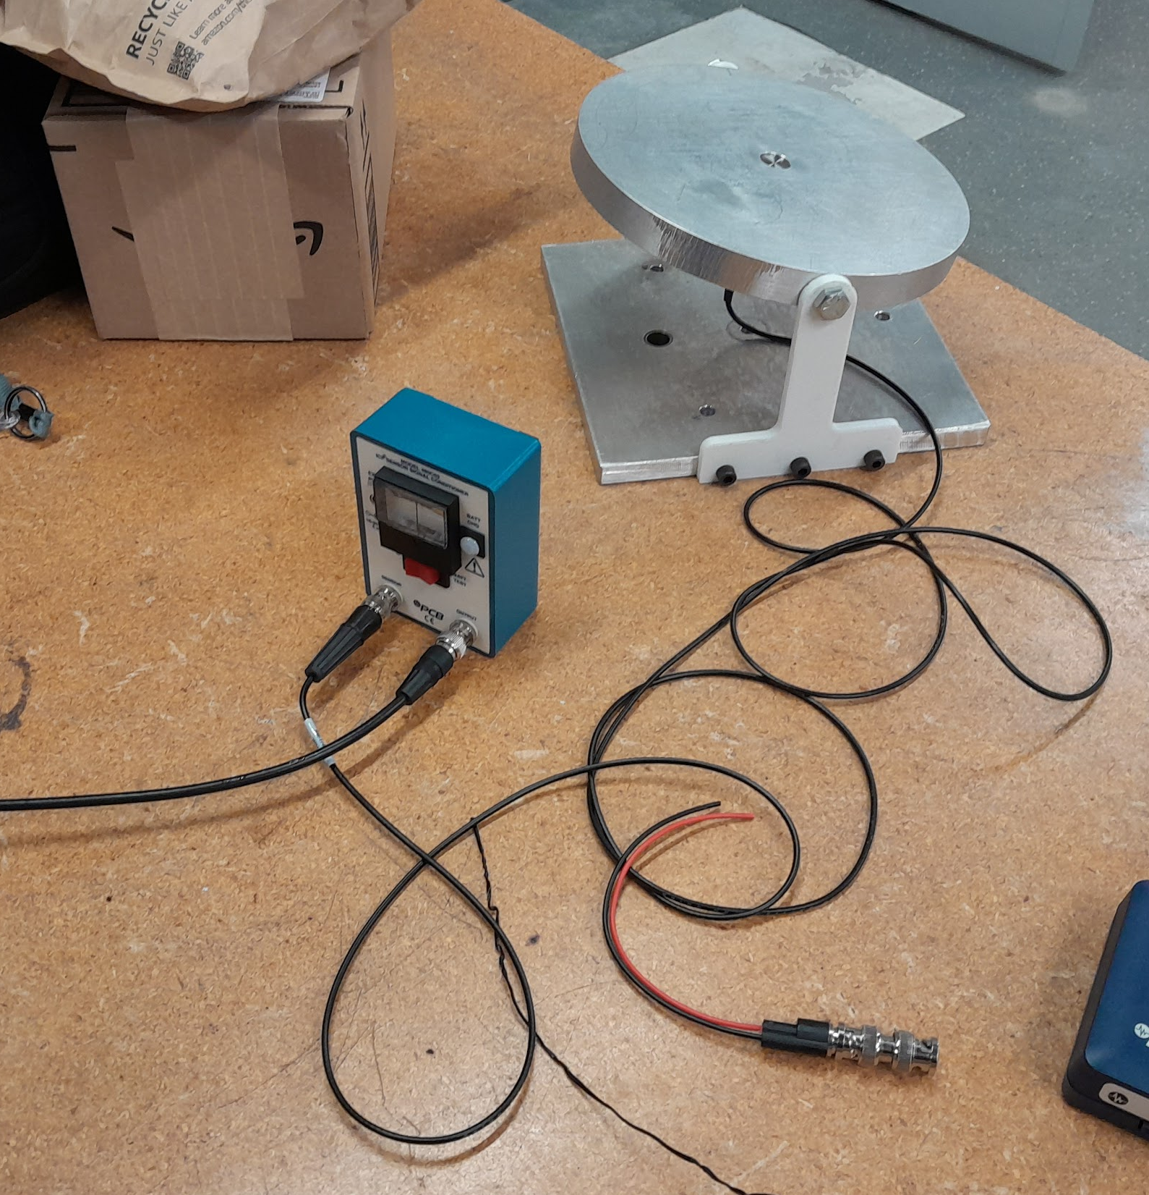
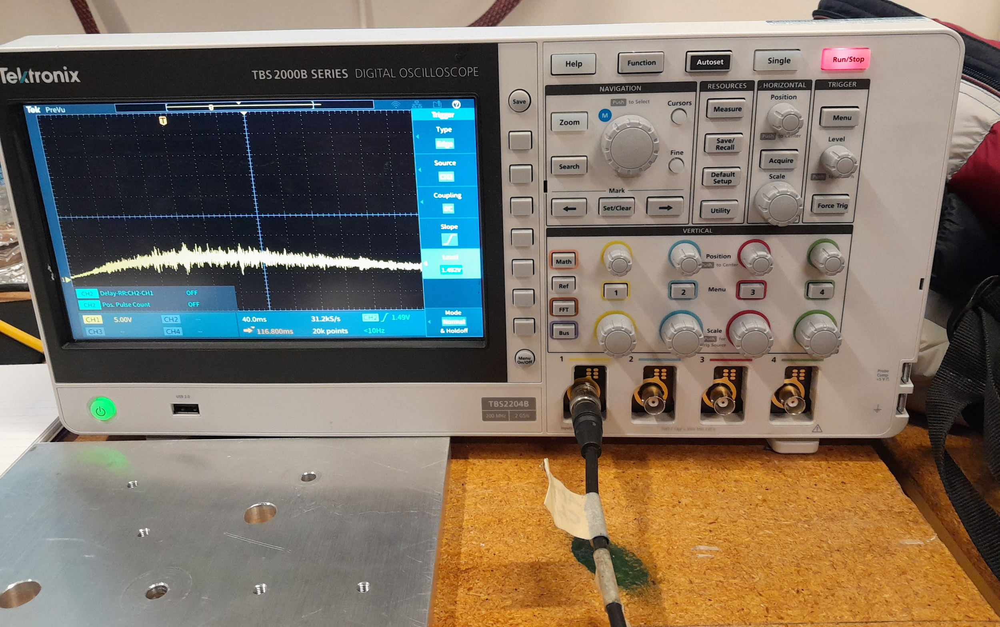
Ambient Testing - Setup
The purpose of the test was to ensure that usable pressure data could be retrieved from the sensor.
The sensor was connected via BNC to an ICP signal conditioner.
The signal conditioner returns changes in voltage to convey changes in pressure
The voltage is detected and recorded by the oscilloscope
The oscilloscope begins recording when the sensor records a threshold voltage
Refrigerant was sprayed on the sensor and the results are shown

Slide 8
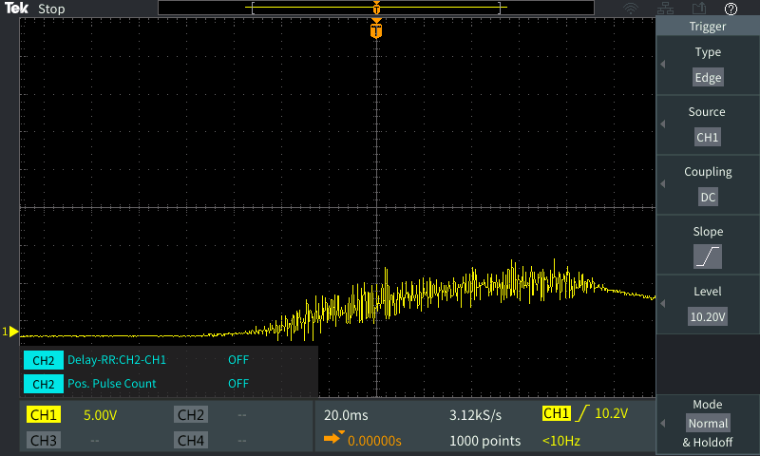
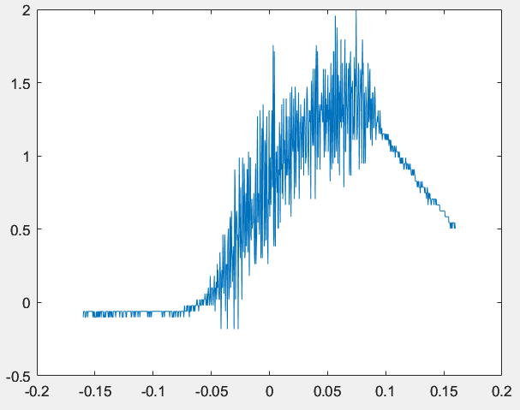
Ambient Testing - Results
Multiple ambient test were conducted using the same setup
A sample plot of voltage over time captured directly from the oscilloscope is shown (top)
The data was exported as a .csv file, imported into MATLAB, and processed into a graph (bottom) of pressure change (psi) over time (s)
Graphs seem proportional in comparison and the MATLAB plot seems reasonable in magnitude
Several problems are apparent
  The signal is very noisy
  The PCB Sensor seems to exhibit an RC response

Slide 9
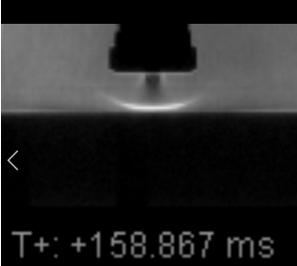
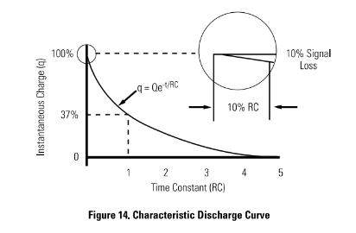
Ambient Testing - Conclusions
Ambient testing was successful and multiple samples of testing data were collected
The PCB Transducer is specified to have an RC time constant of 200ms
  Steady flow seems to develop at t>150ms, depending on the nondimensionalized height
Post-processing techniques may help clean up the signal as well as account for the RC response
  Spectral analysis will be considered
It is possible that the area of the transducer may be too large for the jet stream
The implementation of Kulite sensors is being considered as an alternative should the need arise

Slide 10
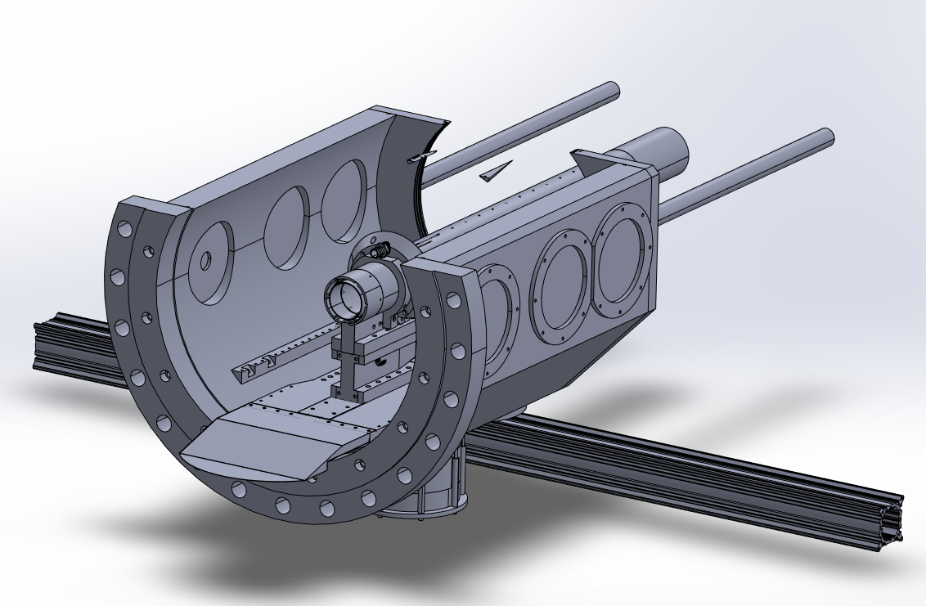
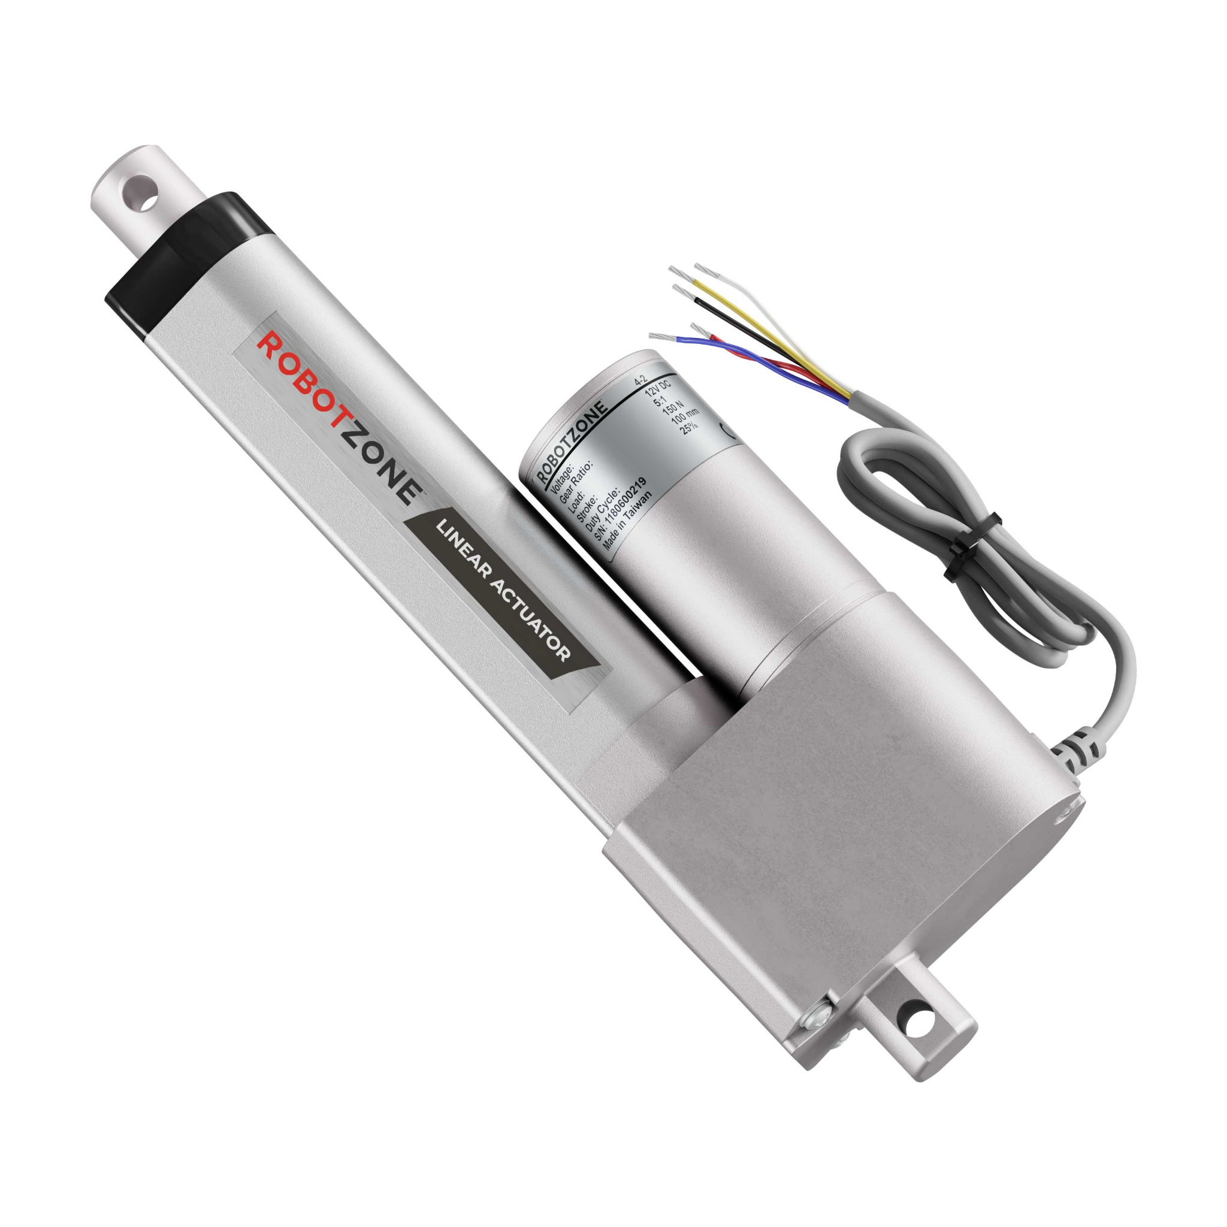
Structural/Space Constraints
Previous linear actuator too large for test section
  Height limitations for imaging through test section window
Use of stepper motor will require machining to reduce the length of the lead screw
Current studies in tunnel limit access to the test section
  Hollow cylinder

Slide 11
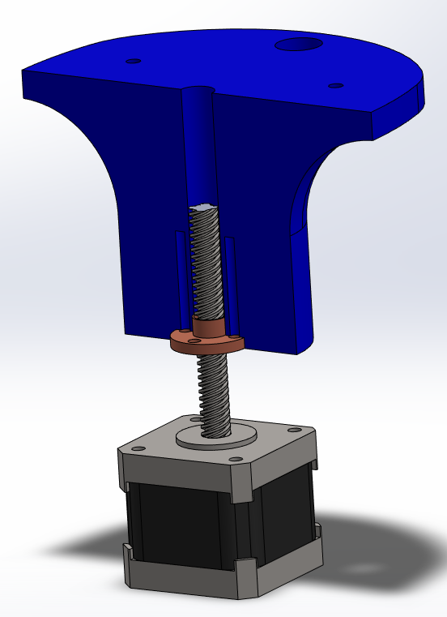
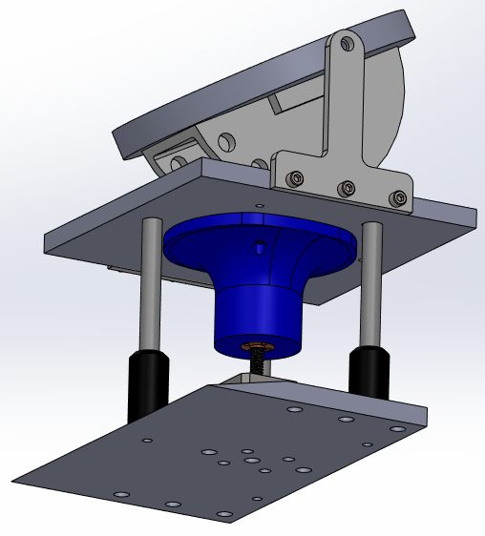
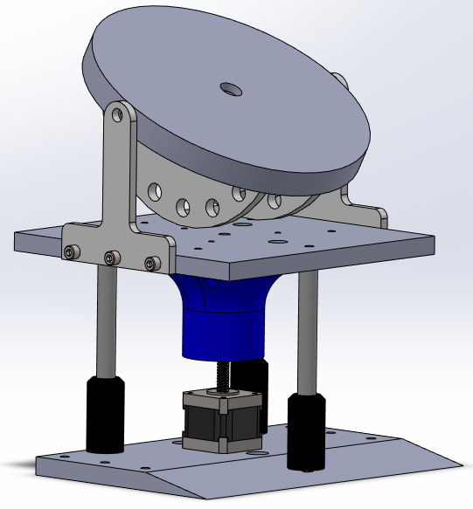
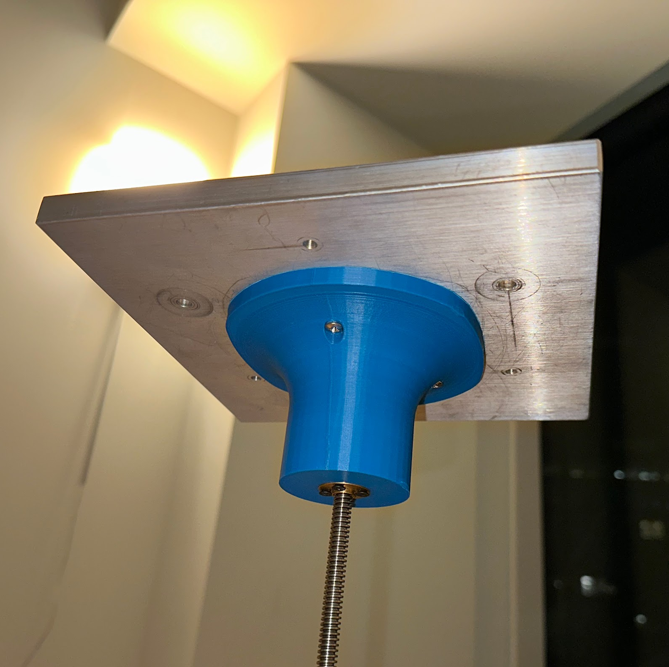
Stepper Motor Accommodations
Swapped square base plates
  Ability to use optical risers for additional vertical alignment
  More threaded connection holes
Used the plate’s predefined geometry to make a motor-plate connection part
  Cavity space for lead screw travel
  Lead screw nut screws into bottom

Slide 12
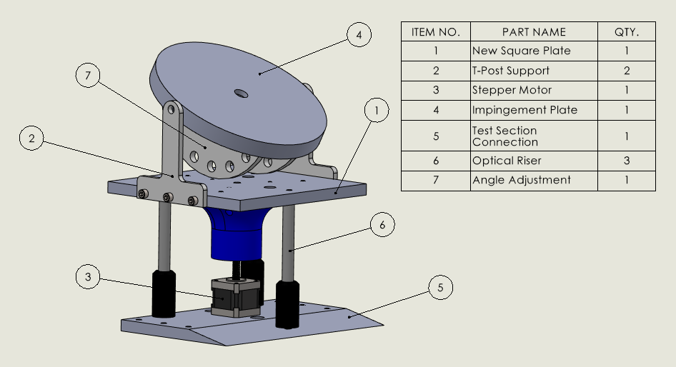
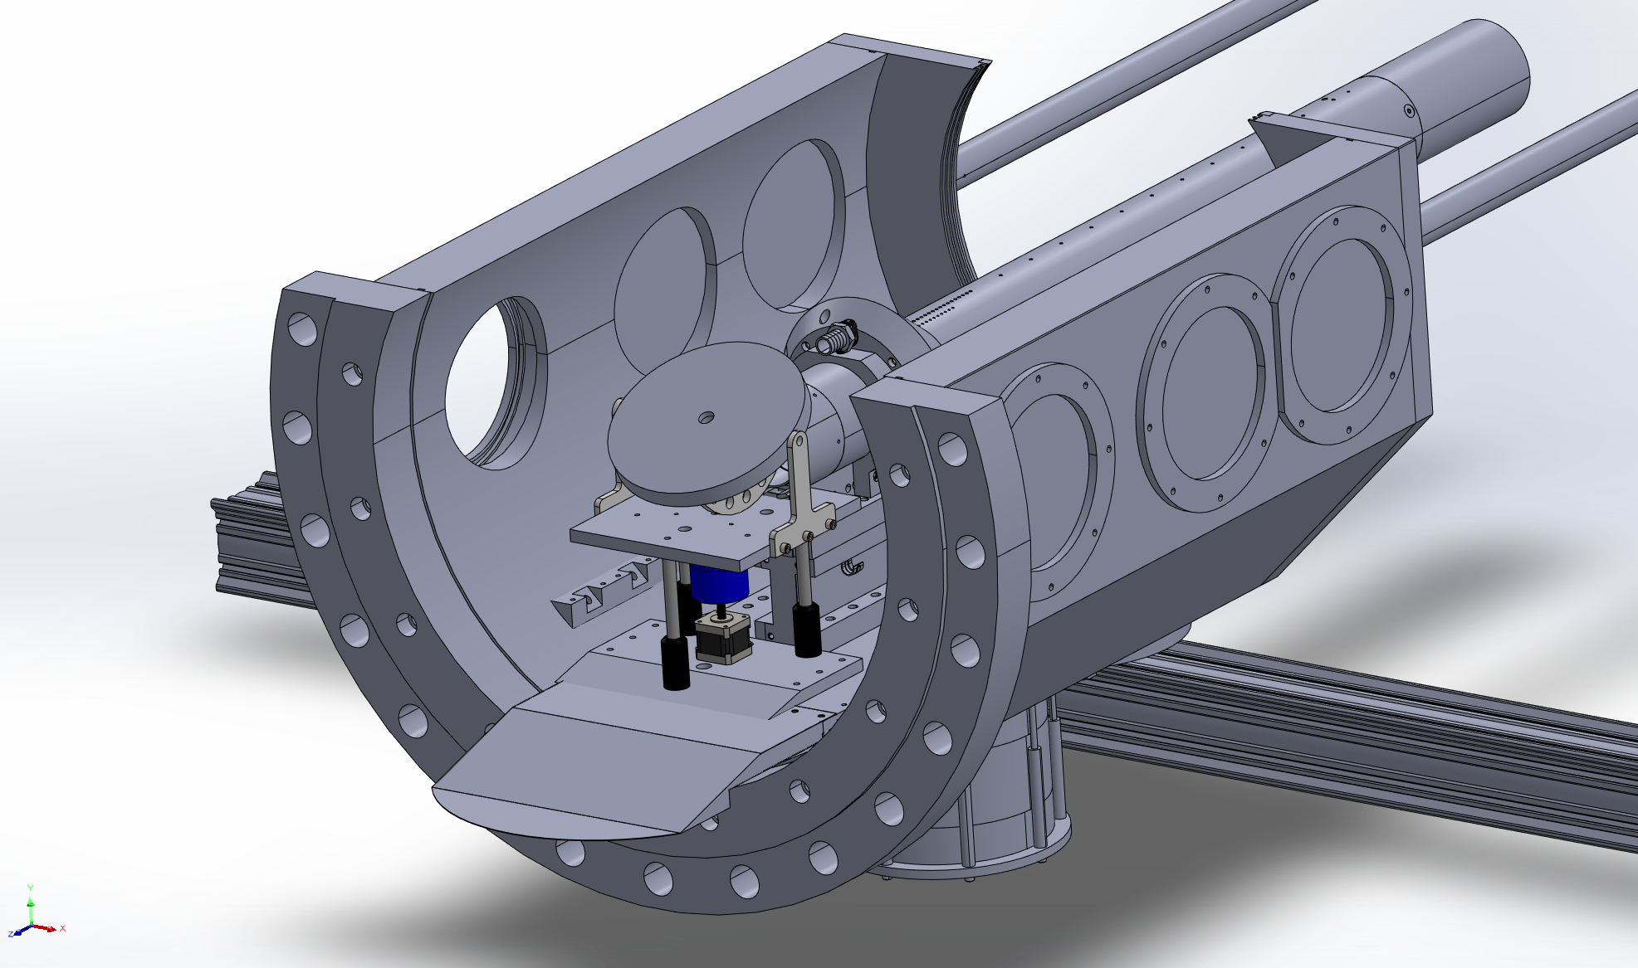
Future Structural Plans/Testing
Create way to hold in pin
  Either additional part that utilizes an available hole on the base plate, or incorporate into t-posts
Redesign of t-posts
  Began to show some deformation
Machine test section connection plate
  Insufficient space → smaller plate design
Vacuum test
  100% infill
  Additional machining may be required

Slide 13
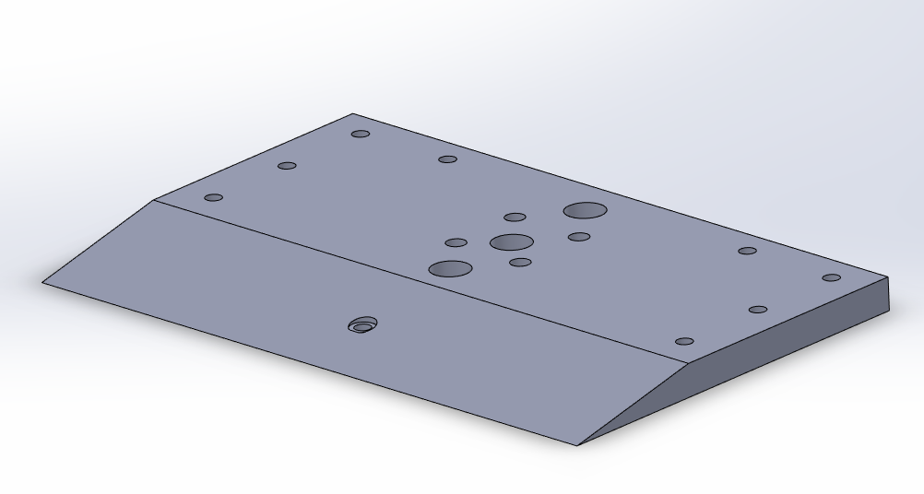
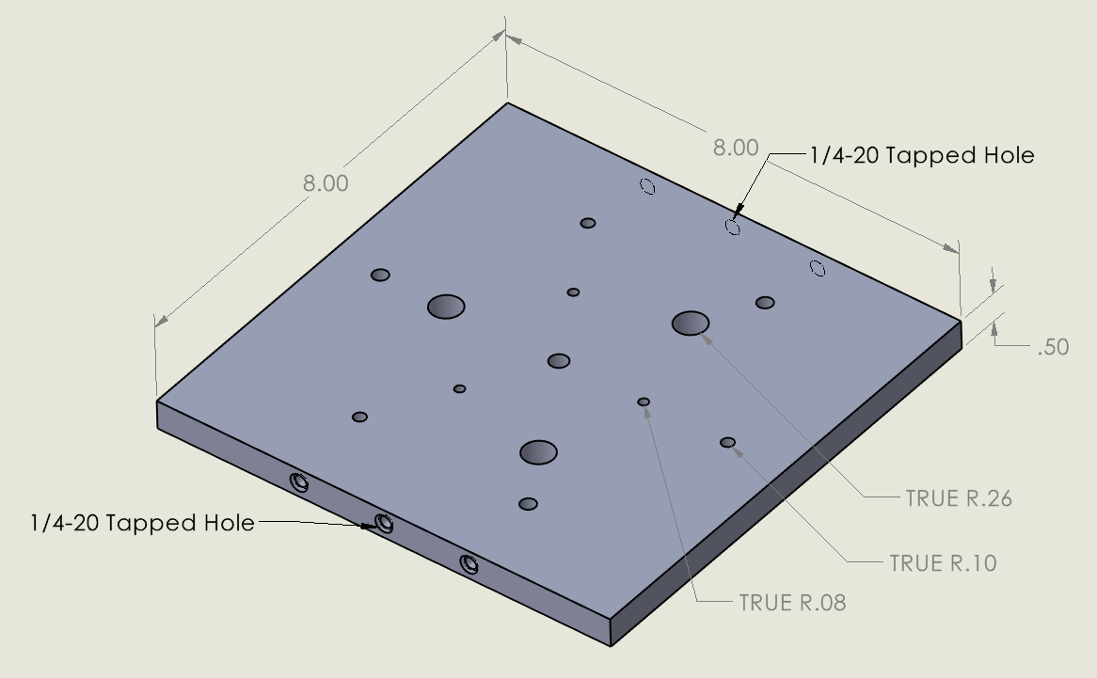
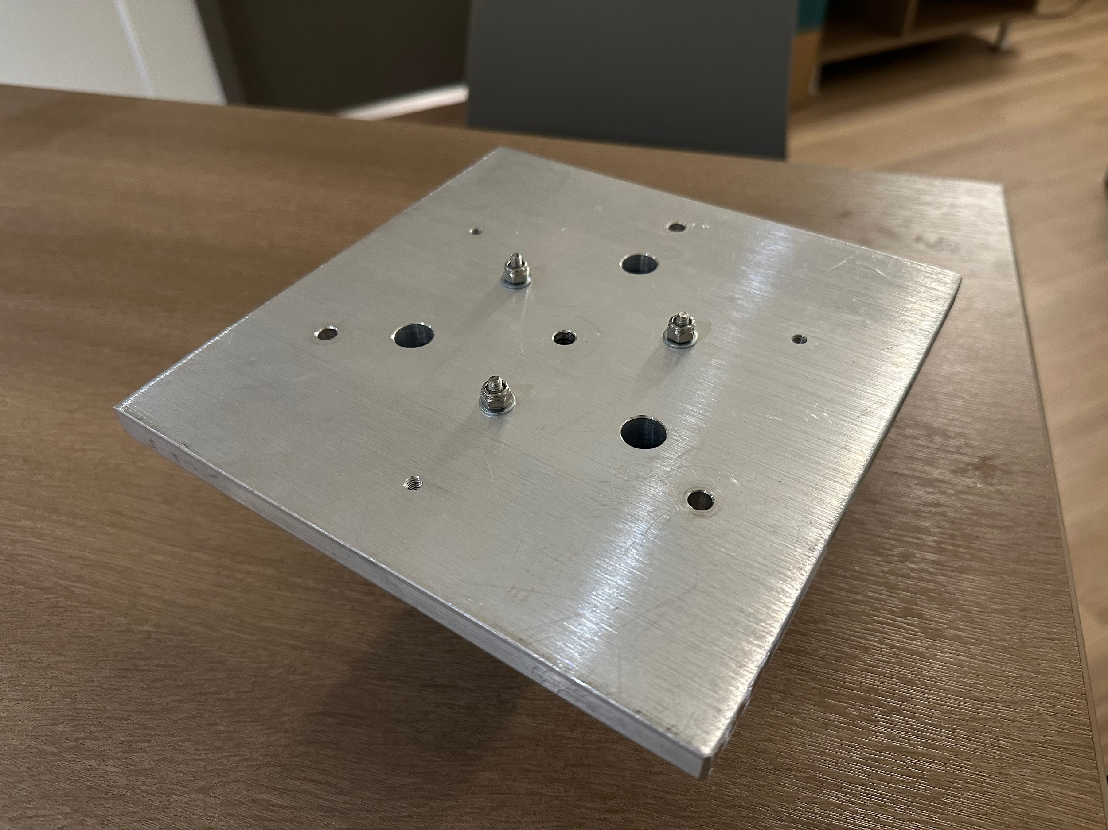
Fabrication Plan
Parts to be machined
  Tunnel mount
    Top priority
    May require additional material
    Design changes in progress
  Square plate
    Ready for machining
  T-posts
    Low priority
Parts to be printed
  Improved angle mount
    Print in progress
  Pin locks
    High priority
    Awaiting design changes

Slide 14
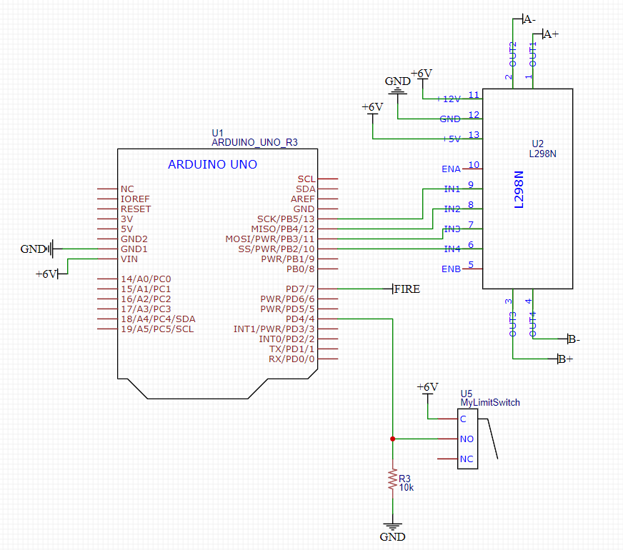
Beta Prototype - Electromechanical Changes
The linear actuator has been replaced by the stepper motor
There is no longer a potentiometer to give real time feedback of the end effector position
Stepper motor moves in discrete steps, so it will be used in conjunction with a limit switch to accurately predict the end effector position
The system will be powered with an external power supply set to 6V, 1.5A
The arduino will still exist inside the test section and will communicate with the arduino via USB

Slide 15
Timeline for Build
Part Fabrication
February 20th - March 10th
  Machining, printing, test fitting
Assembly of Beta prototype
Week of March 20th
  “Final” assembly and adjustment of physical components
Ambient testing of full system
Immediately after assembly
  Finalize experimental procedure
Full test
End of March
subject to Tunnel availability

Slide 16
Alpha Prototype Conclusion
The alpha prototype brought attention to many problems with our current design
The upcoming beta prototype will require major changes.
The linear actuators will be replaced with a stepper motor.
The transition to the stepper motor is expected to improve performance.
Ambient testing has also introduced some new problems
The beta prototype is expected to be fully functional unlike its predecessor.

Slide 17
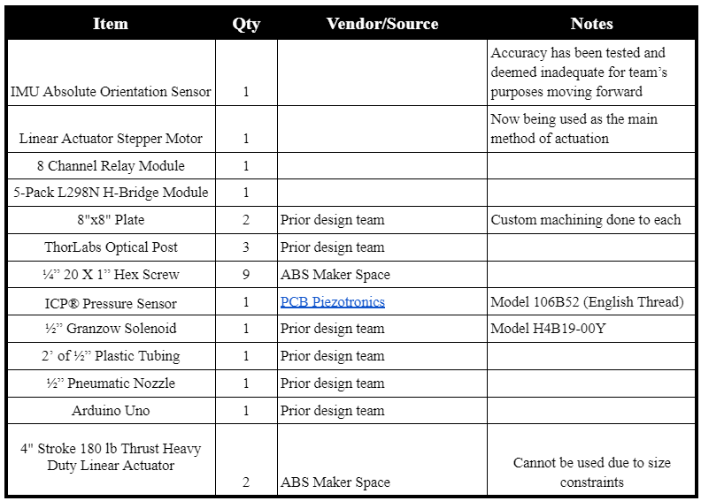
Bill of Materials for Beta Prototype

Slide 18
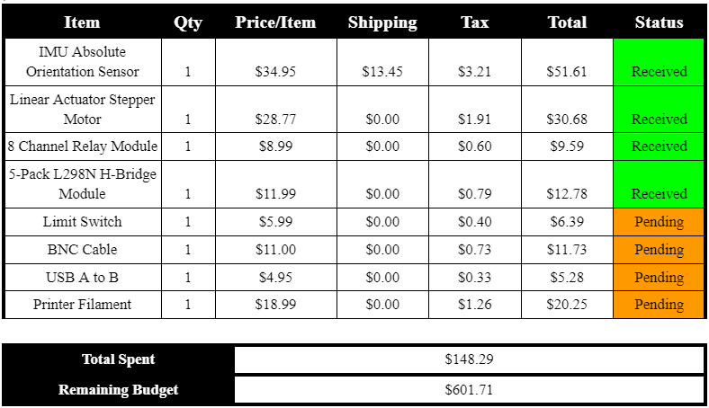
Budget

Slide 19
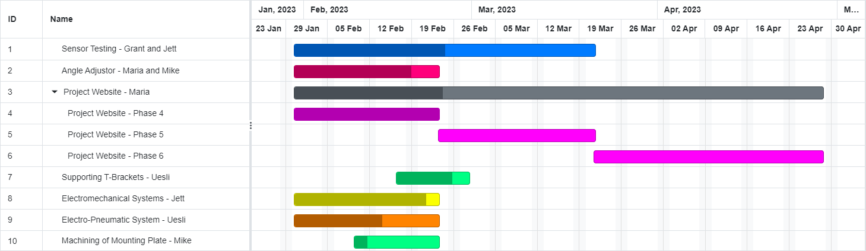
Gantt Chart
Notes:
Sensor Testing - 2 parts atm and vacuum
Angle adjuster - done just need to adjust screw holes
Electromechanical - need to put together
Machining - need to 3d print then machine

Slide 20
On the Horizon
Vacuum Test
Pneumatic documentation update
  Currently using shop air - controlled nitrogen flow would be preferable
Merge subsystems
Refine post processing techniques
Update project website

Slide 21
QUESTIONS?

