Slide 1
Plume Surface Interactions on the Moon and Mars
Phase 1
Team members: Grant Brickner, Michael Burgos,
Jett Langhorn, Uesli Keta, Maria Ortiz
Project Advisors: Prof. Rabinovitch, Prof. Parziale

Slide 2
Overview
Background and Motivation/Problem Statement
Stakeholders
Current Methods Review
Scope of Project
Conceptual Designs
House of Quality/Decision Matrix
Technical Approach
Budget
Gantt Chart/Deliverables
Conclusion

Slide 3
Background and Motivation
When landing vehicles (rockets, planes, helicopters, etc) on the ground surface (of any planet), the exhaust interacts violently with the ground.
Particles kicked up during interaction.
Unnecessary heating due to unsteady conditions.
Damage to vehicle body.
Damage to or loss of instrumentation.
Visibility reduced or blocked entirely.
While these interactions can be modeled using CFD methods, there is no effective method of modeling the problem experimentally. This project aims to fill that space in our understanding.
Safer landings for future vehicles on Earth and in space.
Prevent mission failures due to avoidable landing hazards.
Allow for more complex missions and landing sequences.
Notes:
Background and motivation: for example, when landing rockets on surface of planet, violent interaction, exhaust interacts with ground, particles kicked up and heated. Can cause damage to vehicle, also limits visibility. CFD models but limited experimental data (summary from report, will reword).
Understanding interactions = safer landings of spacecraft, aircraft (ex helicopters or planes)

Slide 4
Problem Statement
The goal of this project is to design an experimental apparatus to model plumes at high speeds, at conditions like that of the Moon or Mars.
Plate to act as landing surface.
Mach 1 (or higher) nozzle to create plumes.
Integrated data collection system.
Adjustable “landing” angles to simulate varied landing conditions.
Adjustable apparatus height and positioning.
Compatible with existing Stevens Shock Tunnel apparatus.
High measurement accuracy and consistency.
Notes:
Problem statement - needs, requirements, general goals.
Create experimental setup to produce flow @ similar speeds + conditions to moon (vacuum), design plate to act as moon surface, data collection system integrated
Adjustable ‘landing’ angles of plate to simulate varied landing conditions
High measurement accuracy and consistency
Compatible with existing apparatus (shock tunnel)

Slide 5


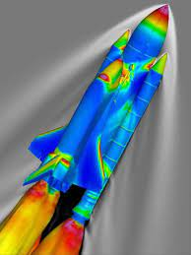

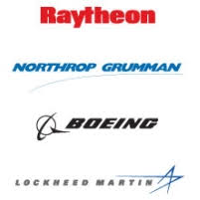

Stakeholders
Plume Surface Interaction is a field of interest for:
Computational Fluid Dynamics
Lunar and Martian Missions
Defense
NASA OVERFLOW Overset Grid CFD Flow Solver

Slide 6
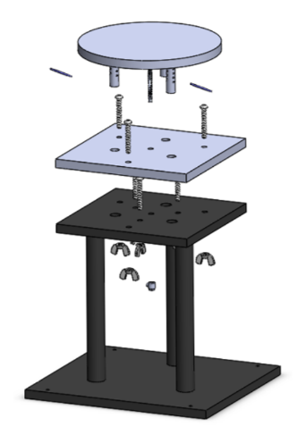
Current Methods review
The current methods the team reviewed are based off of the work done by last year’s team.
Tested on a 90° flat plate with a Mach 1 nozzle in low pressure conditions.
Plate was designed to allow height adjustment via screws
Data collected primarily through Schlieren imaging
Previous Team’s Plate Design

Slide 7
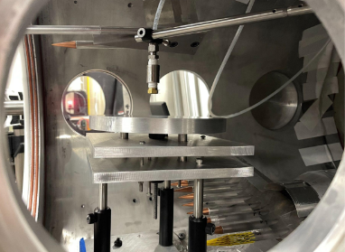
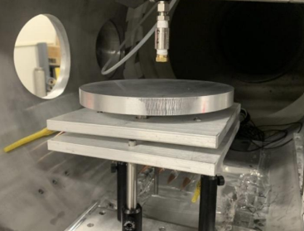
Current Methods review
Previous Experimental Setup

Slide 8
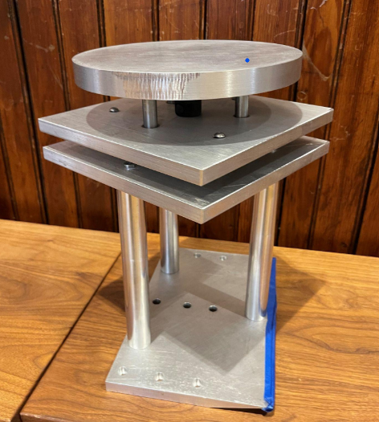
Current Methods review
Primary areas of concern for previous design:
Data Acquisition
Issue: limited empirical data during tests
Plate Adjustment
Issue: plate could not accurately be adjusted
Speed of adjustment during testing
Issue: tunnel needed to be reopened between tests
Plate Stability
Issue: plate vibrations during tests
Previous Team’s Plate Design

Slide 9
Scope of Project
This work will result in a a new experimental apparatus that improves upon the limitations of the current method’s design.
Reliable and consistent adjustments of equipment
  Automation
Faster adjustments
  Allow for more data collection in limited time
Simplified and straight-forward setup process
  Less tinkering with equipment between trials
Collect data for comparison to CFD model
  Test accuracy both of CFD and of experimental setup
Notes:
Team will create new experimental setup that improves upon those points listed from the last design
Take data and correlate it to cfd model to test accuracy
More data collection, adjustable conditions
Reliable/consistent adjustments
Simplified adjustment/setup process

Slide 10
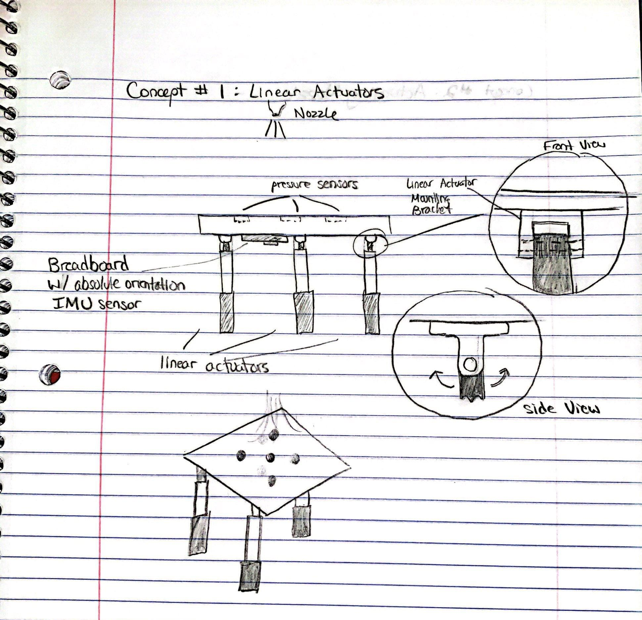
Conceptual Design #1: Linear Actuators
Key Concepts
3 linear actuators w/ hinge joints at ends
  Different combinations
Absolute Orientation IMU sensor for angle accuracy
Fixed nozzle

Slide 11
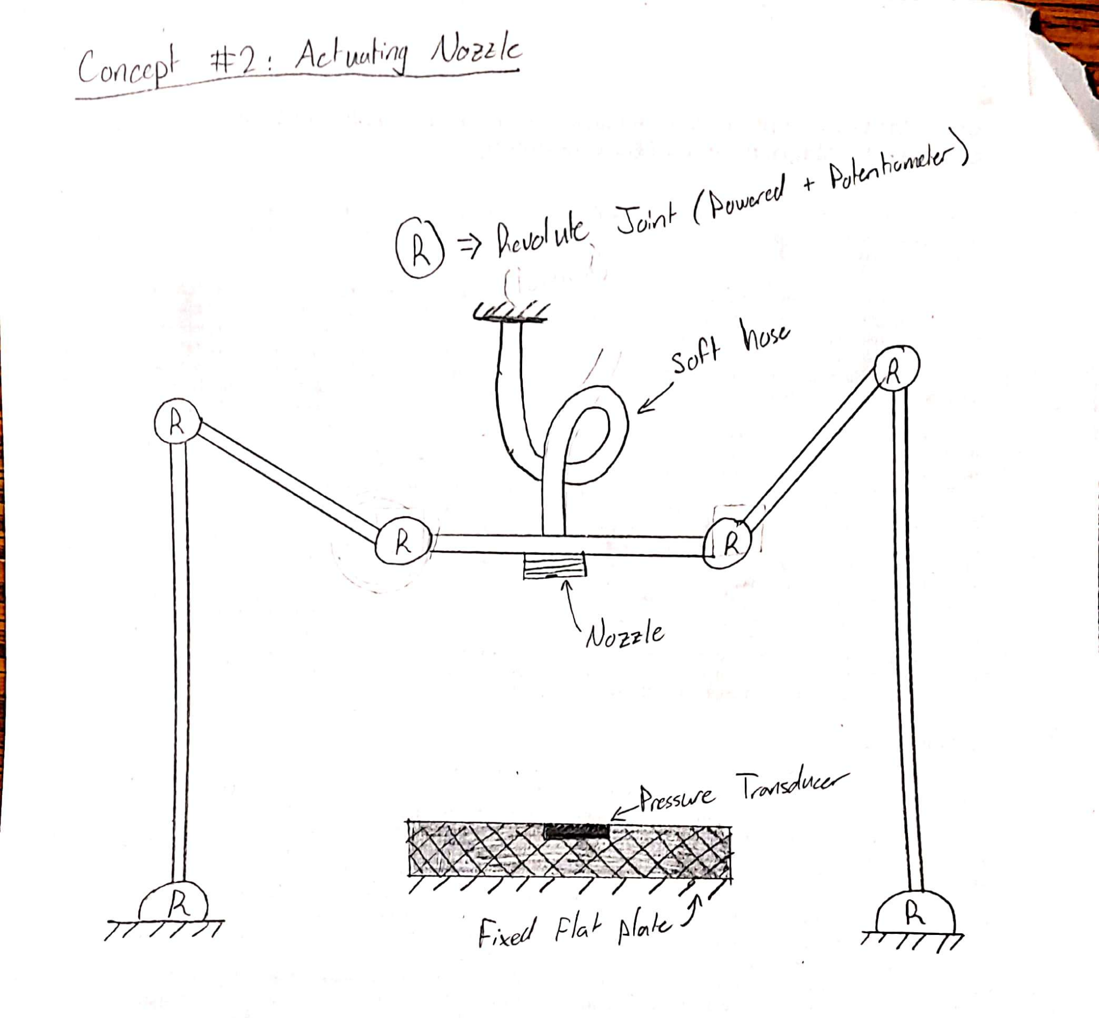
Conceptual Design #2: Actuating Nozzle
Key Concepts
Fixed base plate
Linkage powered by stepper motors and potentiometer inputs
Soft hose to allow for nozzle height adjustment

Slide 12
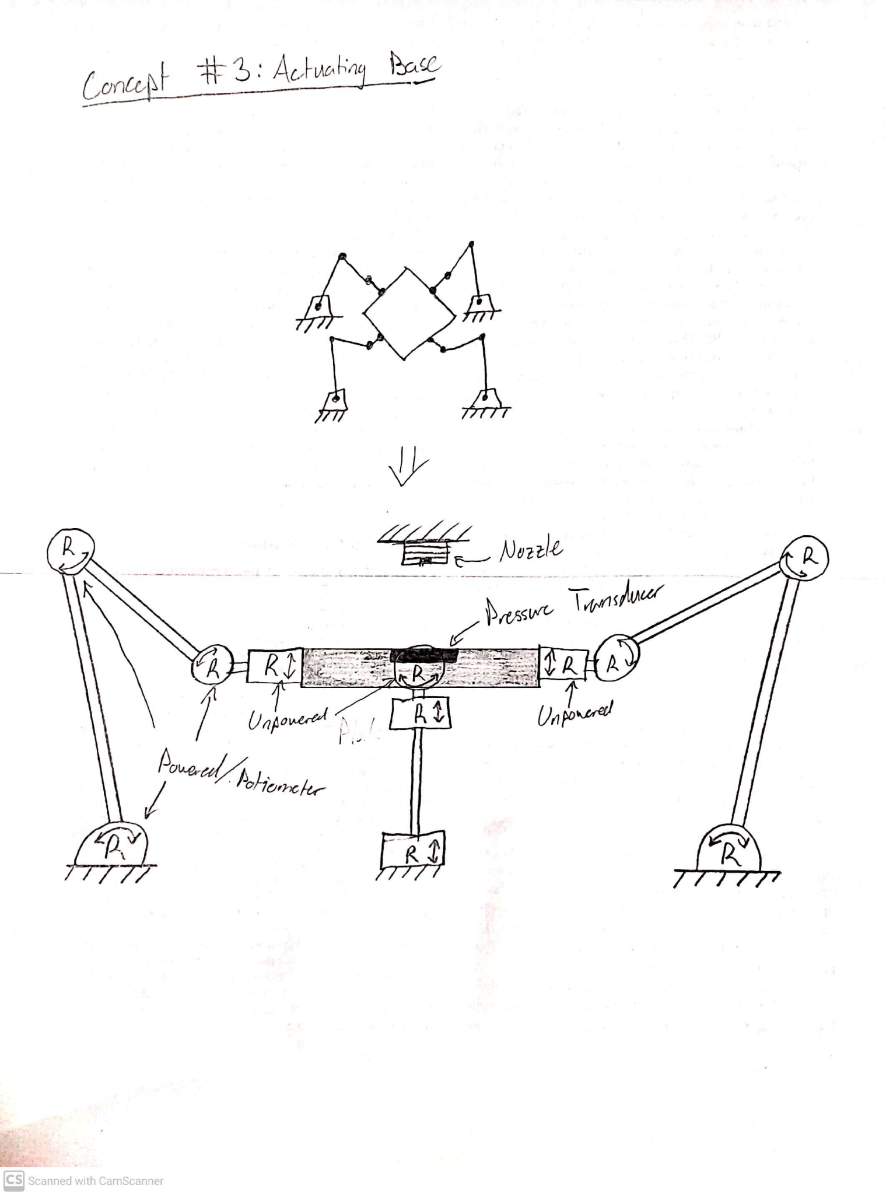
Conceptual Design #3: Actuating Base
Key Concepts
Linkage powered by stepper motors and potentiometers
Fixed nozzle
Arm attached to each side of flat plate
Concerns
Future decisions regarding concepts based on feasibility
  Purchase all components, might still experience shaking
Importance of Technical Analysis
  calculations/simulations will provide better insight to whether the concepts can handle the pressure forces

Slide 13
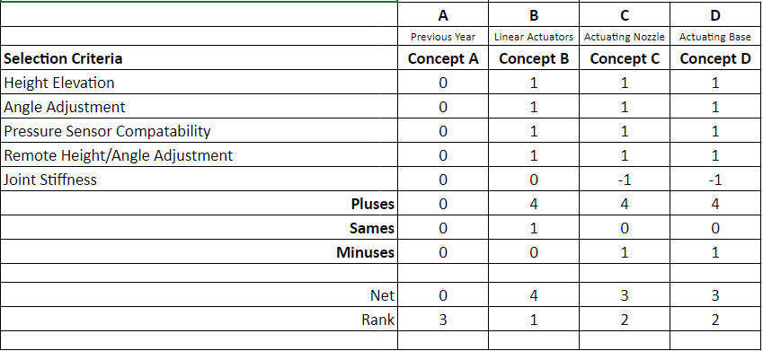
House of Quality / Decision matrix
Concept designs compared to last year’s project “Concept A”
Given 1 if better
Given 0 if same
Given -1 if worse

Slide 14
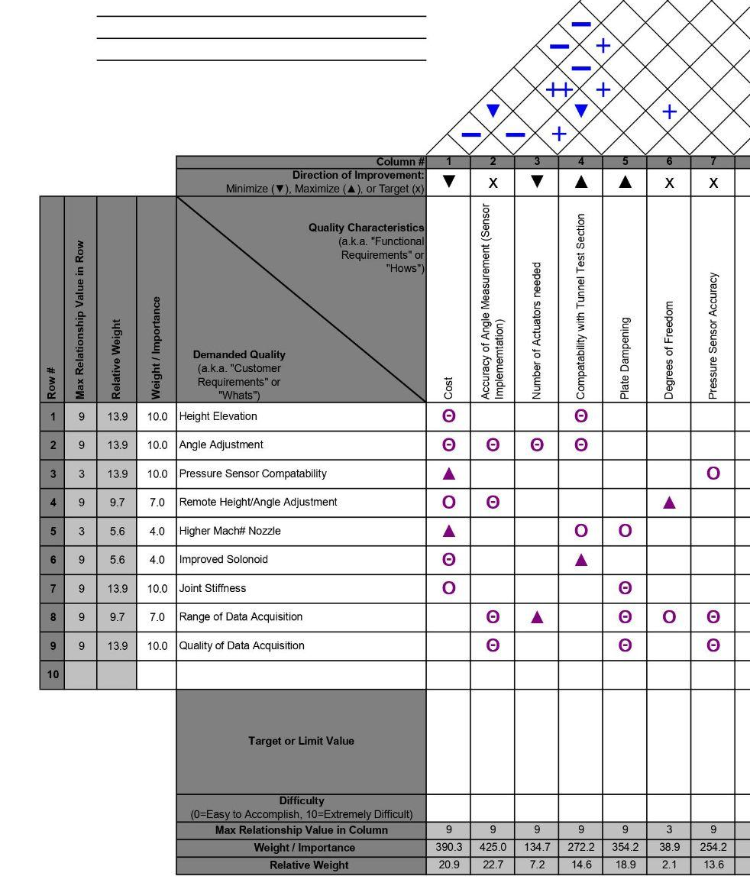
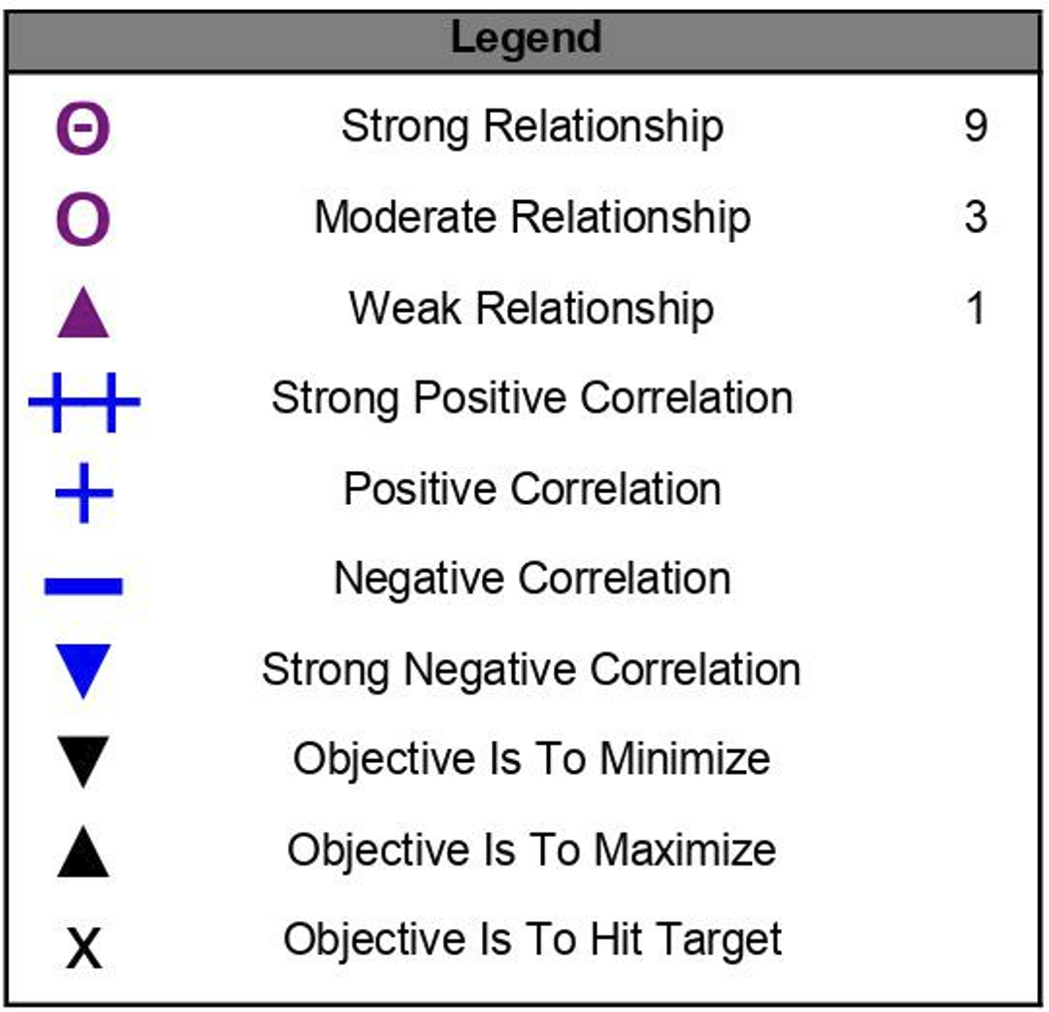
House of Quality / Decision matrix
Customer Requirements
Height elevation
Angle Adjustment
Pressure Sensor Compatibility
Remote Height/Angle Adjustment
Higher Mach# Nozzle
Improved Solenoid
Joint Stiffness
Range of Data Acquisition
Quality of Data Acquisition
Primary costs will go into base plate height/angle control

Slide 15
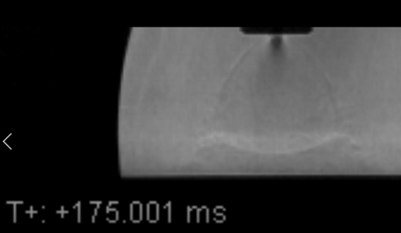
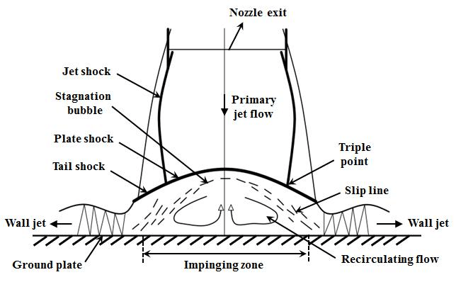
Technical Approach
Plan to estimate the forces/moments experienced on the plate
Subsequently the forces/moments on the links and joints of each design can be estimated
Data will be used to determine the feasibility of each design as well as provide insight for motor specifications
Plan to carry out numerical calculations (Matlab) as well as simulations (Ansys).
  Numerical calculations will represent a simplified conservative model
  Simulations will yield more realistic, but less conservative results.

Slide 16
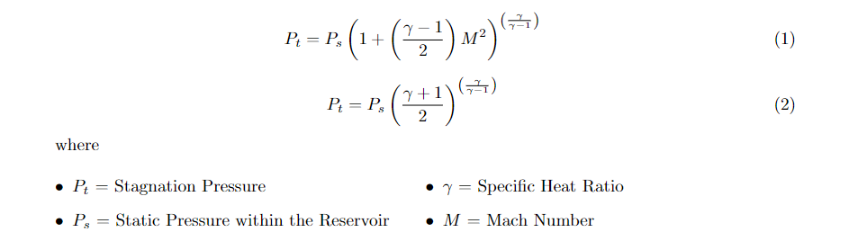
Technical Approach: Numerical Approach
Assumptions:
  Inviscid Flow
  All flow will stagnate when impinged
  Specific heat ratio will remain a constant
  Test section will be held at vacuum
Variables:
  Nozzle orientation with respect to plate
  Mach speed
  Nozzle height
Preliminary analysis will replicate the conditions present during the experimental tests conducted last year
Force and distance vectors will be generated for a range of variables, giving insight to system hardware requirements and system limitations

Slide 17
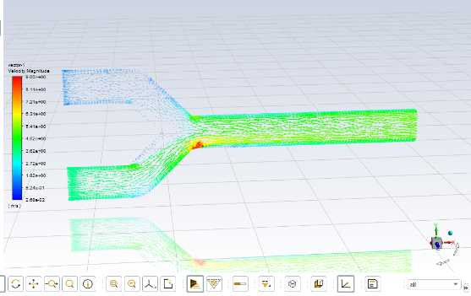
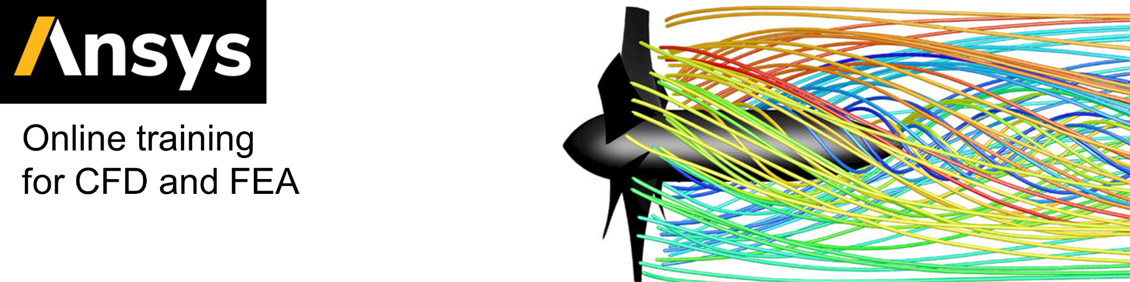
Technical Approach: Simulations
Modeled and simulated on Ansys
Fluid will be assumed viscous
Expectations:
  Provide more realistic force/pressure predictions
  Provide insight to unforeseen problems/oversights
  Transient analysis may give insight to shaking/vibrations caused by starting flow
  As mach speed increases, the simulation may become less accurate/become more computationally expensive
Results will be compared to numerical approach as well as experimental schlieren imaging
Static structural analysis may also be necessary

Slide 18
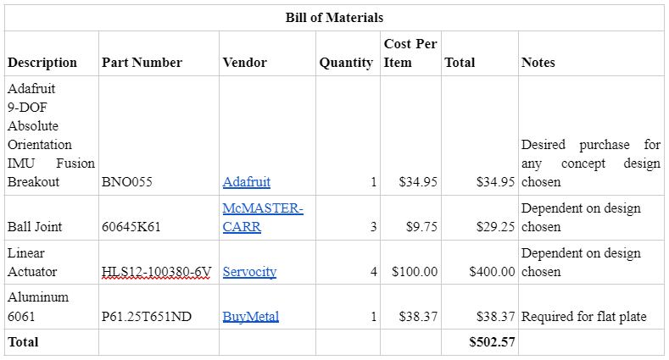
Budget
Starting budget of $750. This budget is prone to change as we progress through the project
Current plan for budget

Slide 19
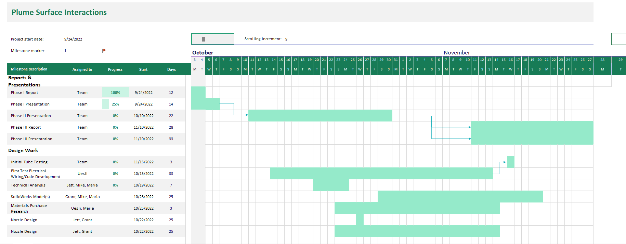
Gantt Chart
Notes:
From top left: Phase 1 report, phase 1 presentation, phase 2 presentation,phase 3 report, phase 3 presentation
From top down: Initial tube testing, Wiring/code, tech analysis, mats research, nozzle design,

Slide 20
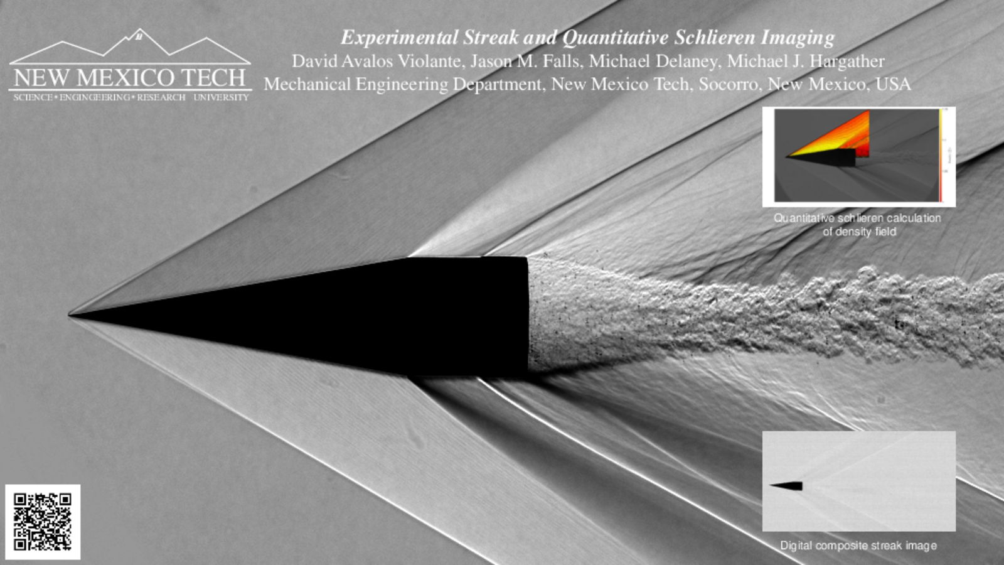
Deliverables
Flat Plate
  Needs to be sturdy
  Needs to gather data
  Needs to change angle
Nozzle
  Effectively aim Mach 1 flow onto flat plate
Wiring/Code
  Connect to camera to be able to catch Schlieren imaging
CFD Models
  Comparison with experimental results

Slide 21
Conclusion
Aiming to improve from pre-existing design
Actuators seems to be the design choice of interest right now
Technical analysis will reveal which concept design will be feasible
Technical analysis will also reveal additional issues with selecting design
  Vacuum
  Current/voltage draw
  Vibration analysis
Schlieren imaging will be useful when experimenting, allowing for visual comparison
Notes:
Overall, there is much to improve from the pre-existing sonic impingement design. The team is confident in their choice to implement robotic actuators in their alpha prototype. Further technical analysis will reveal the feasibility, pros, and cons to each concept design. As the team approaches fabrication, additional considerations are the feasibility of each design to work in a vacuum, the current/voltage draw of each design, and the magnitude and effect of vibrations caused by the start of the sonic jet. Schlieren imaging will be useful when experimenting with the flat plate as it will allow for visual comparisons between different tests, angles.

Slide 22
QUESTIONS?

