Slide 1
Plume Surface Interactions on the Moon and Mars
Phase 5
Team members: Grant Brickner, Michael Burgos,
Jett Langhorn, Uesli Keta, Maria Ortiz
Project Advisors: Prof. Rabinovitch, Prof. Parziale

Slide 2
Overview
Project Recap
Goals and Objectives
Beta Prototype Overview
Current Functionality and Testing Results
Project Timeline
Remaining Work

Slide 3
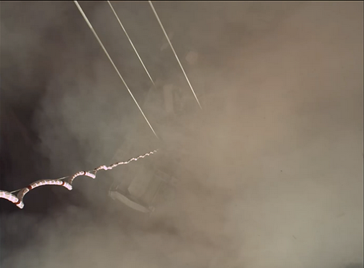
Motivation
When landing vehicles (rockets, planes, helicopters, etc) on the ground surface (of any planet), the exhaust can react violently with uncontrolled ground surfaces leading to:
Loss of visibility
Increased risk of damage to aircraft, mission critical instrumentation, etc.
Uneven landing surfaces (flow creates craters)
There is no effective method of modeling the problem experimentally. Because of this, the accuracy of CFD models on this subject is unknown. This project aims to fill that space in our understanding as well as provide more precise CFD models.
Safer landings for future vehicles on Earth and in space.
Prevent mission failures due to avoidable landing hazards.
Allow for more complex missions and landing sequences.
Provide data for CFD verification
Advance the technology in PSI studies by creating a physical apparatus that can be used in future studies by others
Notes:
Background and motivation: for example, when landing rockets on surface of planet, violent interaction, exhaust interacts with ground, particles kicked up and heated. Can cause damage to vehicle, also limits visibility. CFD models but limited experimental data (summary from report, will reword).
Understanding interactions = safer landings of spacecraft, aircraft (ex helicopters or planes)

Slide 4
Phase I-IV Recap
Assembly:
Remote stepper motor and manual angle adjuster
T-brackets being redesigned to hold the pin for the angle adjustment
Electric/mechanical way of setting reference height for stepper motor
Pneumatic:
Consists of solenoid, camera, and pressure sensor
All need to be activated at the same time
Electromechanical:
Linear actuator: small percent error but was too large to fit into the testing section
IMU Sensor: Not accurate and the same results could not be achieved twice
Stepper Motor: Slower and requires more complicated build. More accurate, cheaper, more compact

Slide 5
Goals and Objectives
Development of Beta Prototype
  Modify necessary parts based upon Alpha Prototype conclusions
  Incorporate all subsystems into design
  Test functionality of stepper motor with plate design and angle adjustment system
Continued development of data acquisition and processing methods
Begin testing in shock tunnel
  Dependent upon shock tunnel availability
  Ensure model compatibility with shock tunnel space available
  Test design functionality under vacuum conditions

Slide 6
Project Deliverables
Initial testing plan
  Conducted testing on the alpha prototype to assess its performance and to identify any design issues that need to be addressed
  Begin to define the test objectives, test environment, test equipment, and test procedures
Beta Prototype production
  Modifications made following consideration of completed Alpha Prototype
  Based upon initial testing results and modification requirements
  Machining
  3D printing new parts/redesign of old parts
Collection of experimental data inside shock tunnel
  Data collection and analysis
Updated project website

Slide 7
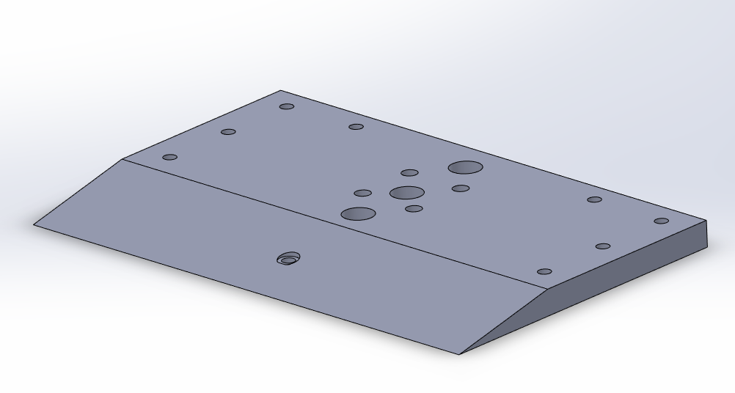
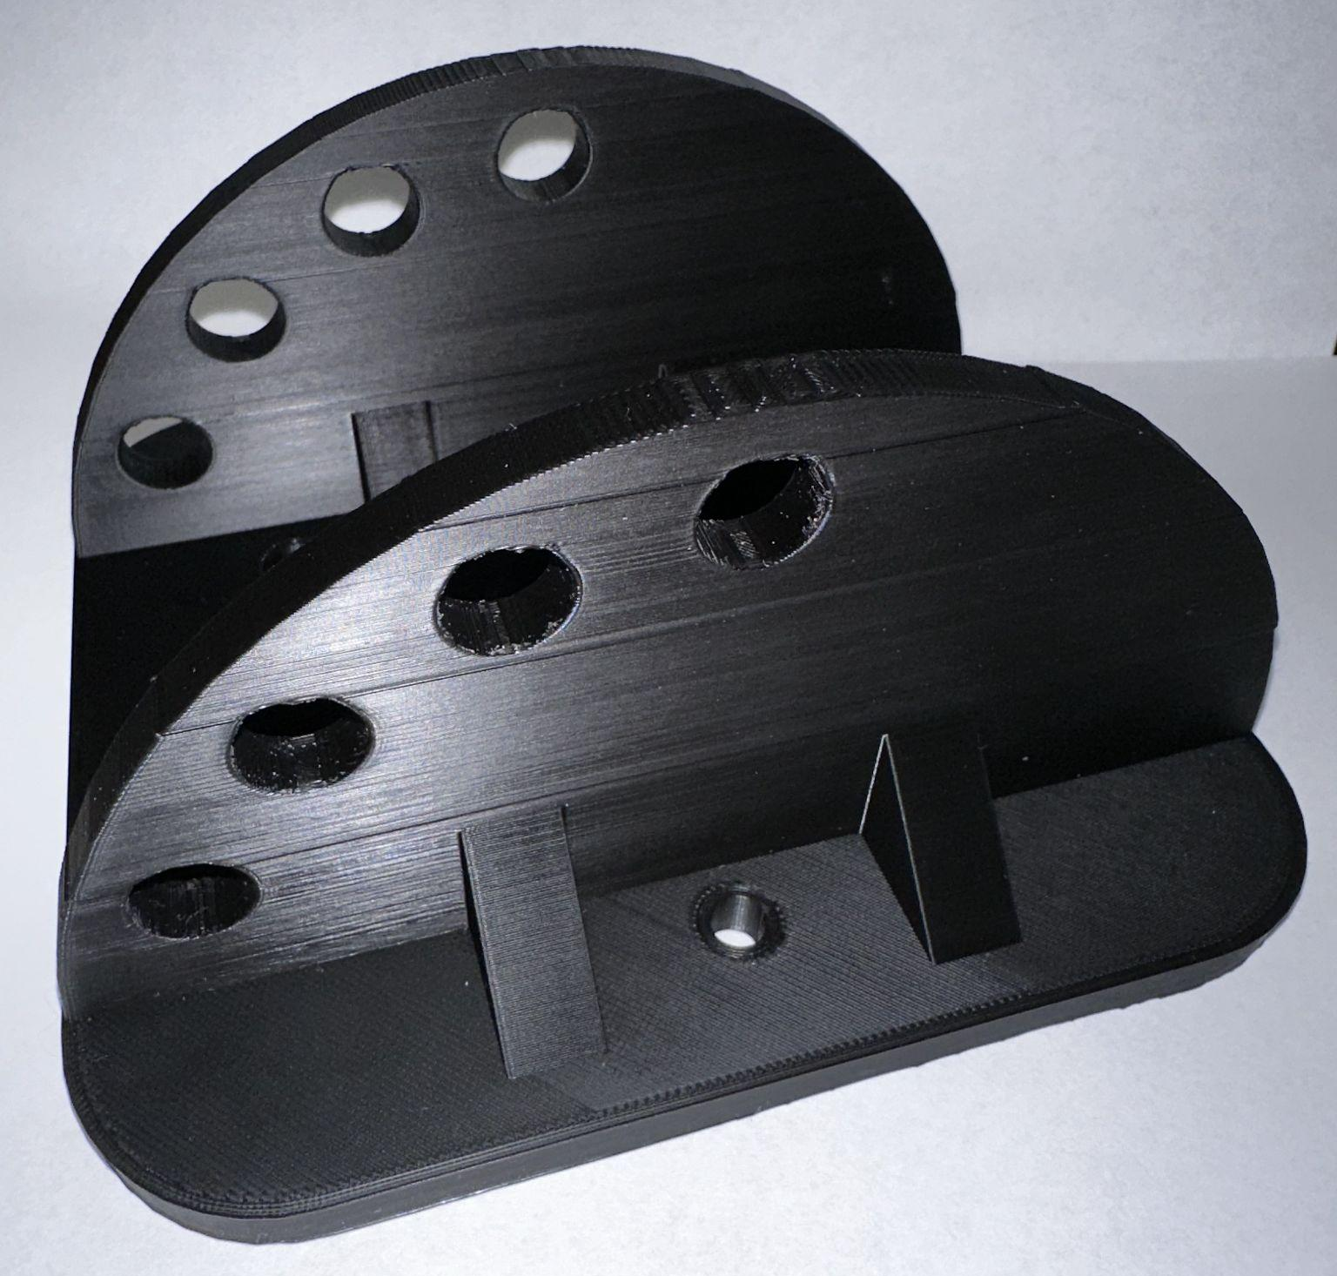
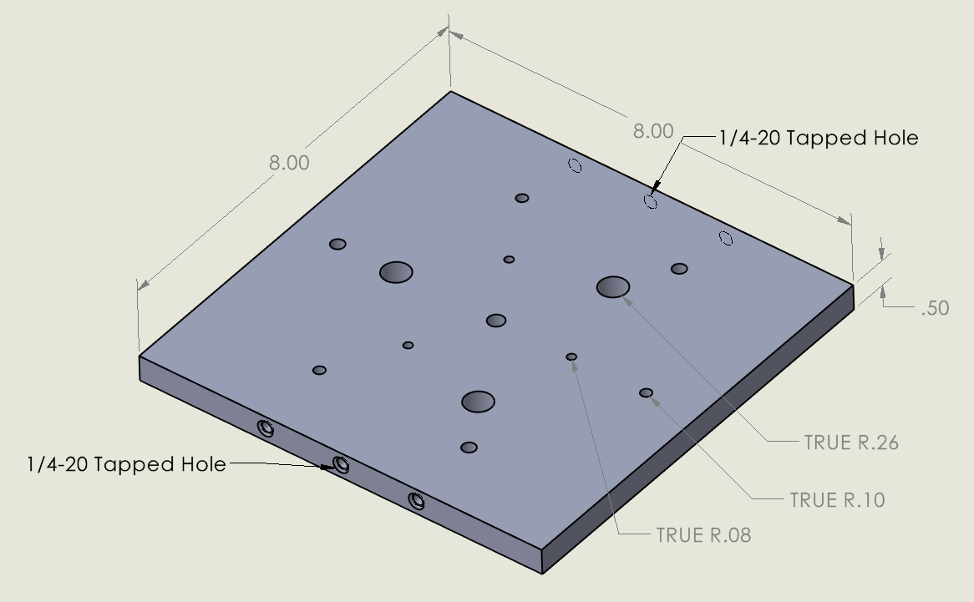
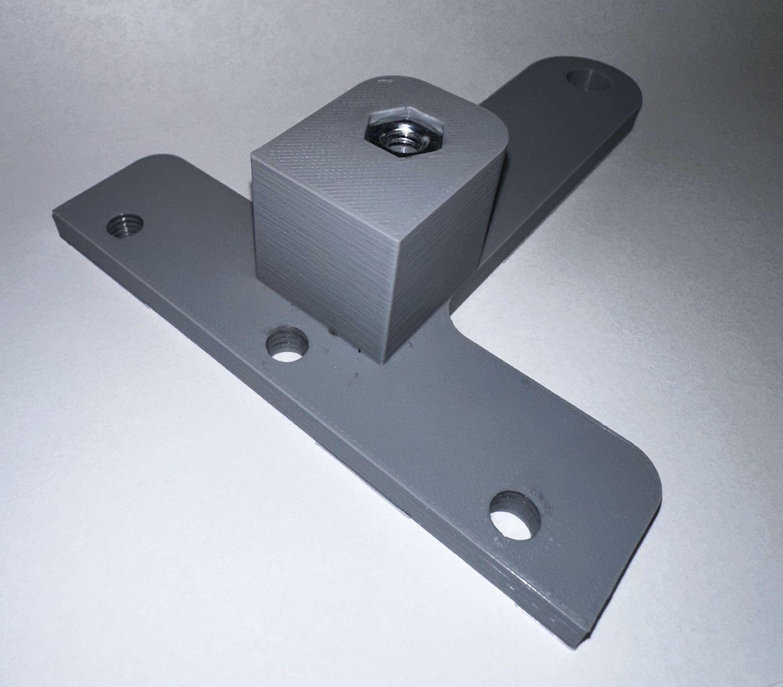
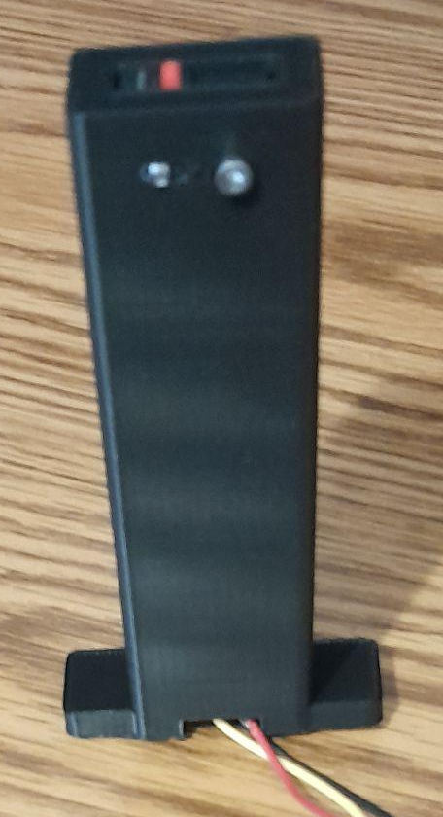
Fabricated Parts
Parts machined/printed
  Tunnel mount
    Drilled mounting holes for the stepper motor
    Added counterbores so it can sit flush in the tunnel
  Angle Adjuster
    Angle Adjustment plate has been printed, better hole placement/supports
  Square plate
    Tapped holes have been drilled to allow T-Posts to mount
  T-posts
    New design has been printed and added to the assembly
  Limit Switch Mount
    Housing for Limit Switch
Notes:
Angle adjuster is centered as previous design was not(allows for cables to be brought through)
T-Posts are more stable

Slide 8
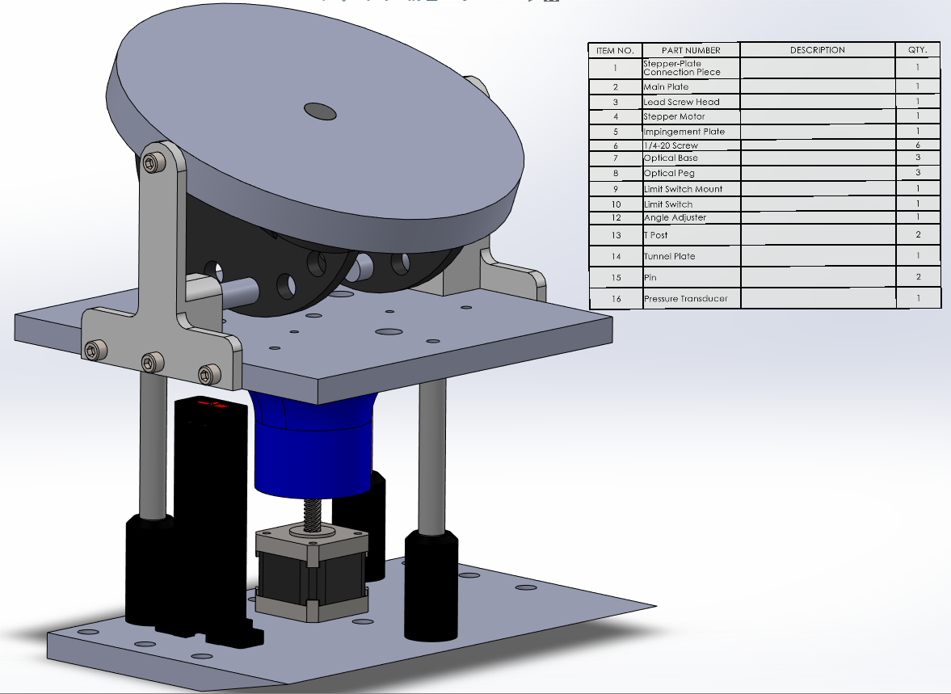
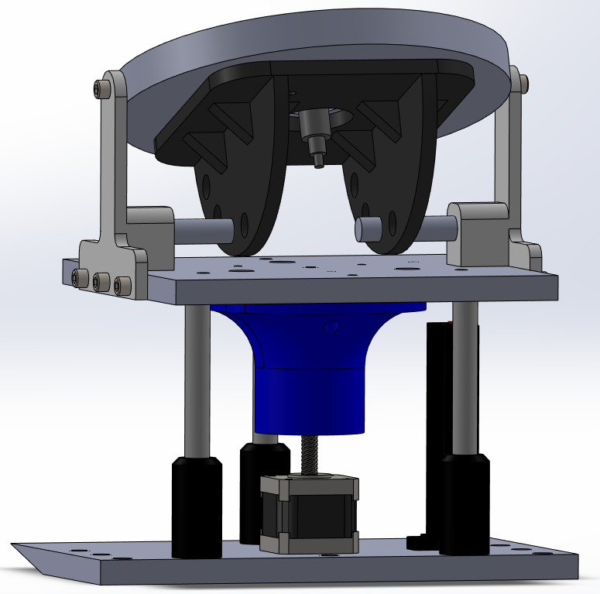
Updated SolidWorks Model

Slide 9
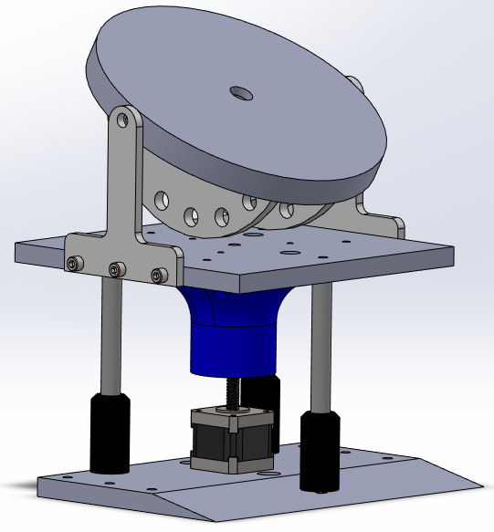
Old SolidWorks Model

Slide 10
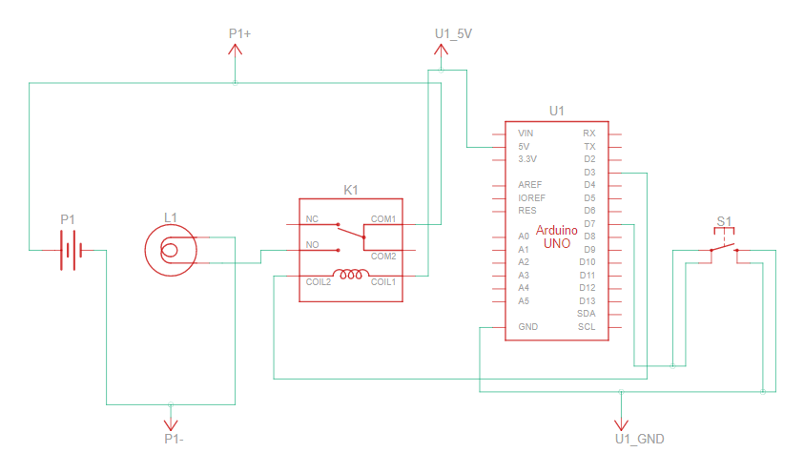
Beta Prototype - Solenoid Updates
The solenoid activates with the push of a button
At the same time the button is pressed an LED also turns on
LED represents signal to send to camera for schlieren imaging

Slide 11
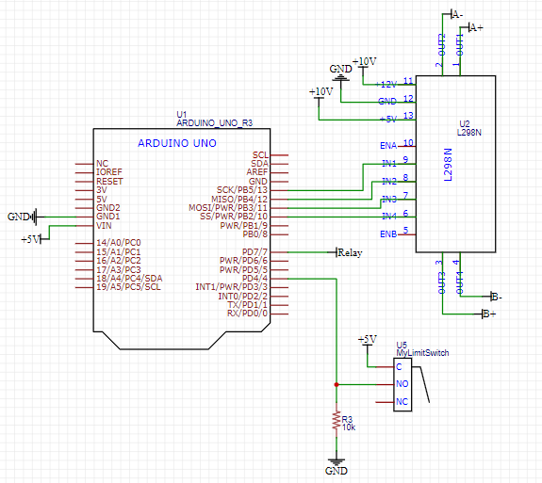
Beta Prototype - Electrical System Updates
The stepper motor succeeded in its ability to move the plate
  10V - 1.5A from a voltage/current limiting power supply
The limit switch was successfully integrated into the physical prototype
  Allows for the setting of a reference height
A USB cable was successfully spliced into multiple BNC cables in order to establish serial communication to the Arduino in the shock tunnel
Parts were ordered for PCB fabrication

Slide 12
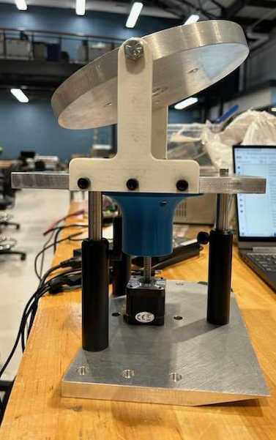
Beta Prototype - Electrical System Problems
An alignment issue involving the stepper motor and optical risers sometimes inhibits movement
  There are plans to meet with the professionals in the machine shop to better diagnose the problem
Overheating may be an issue
  Braking with a stepper motor requires a constant current
  15W is estimated to dissipated as heat
  The current solution involves putting the heatsink directly in contact with the tunnel wall

Slide 13
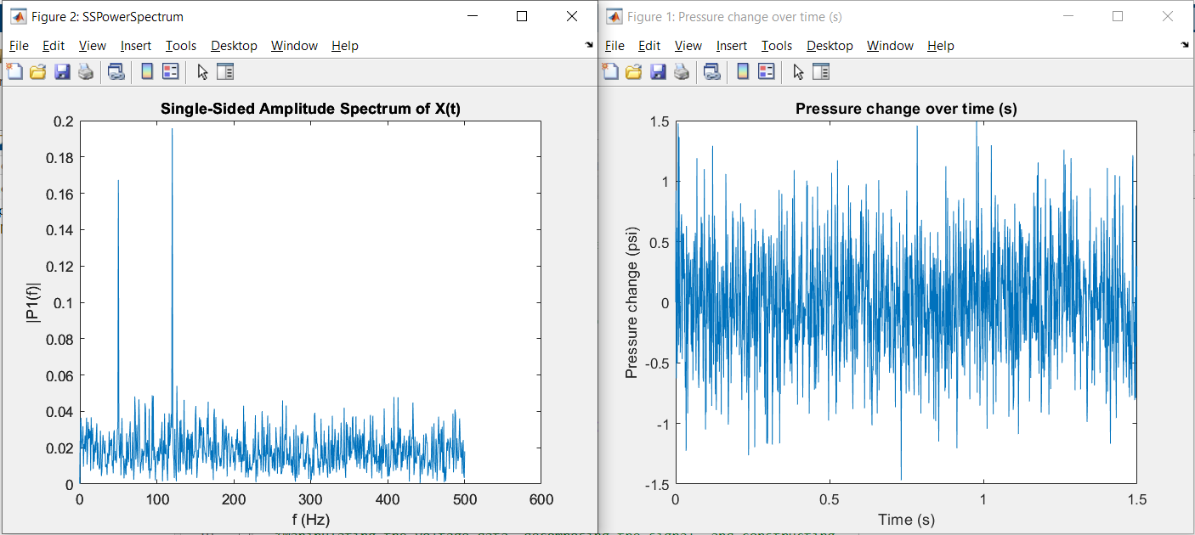
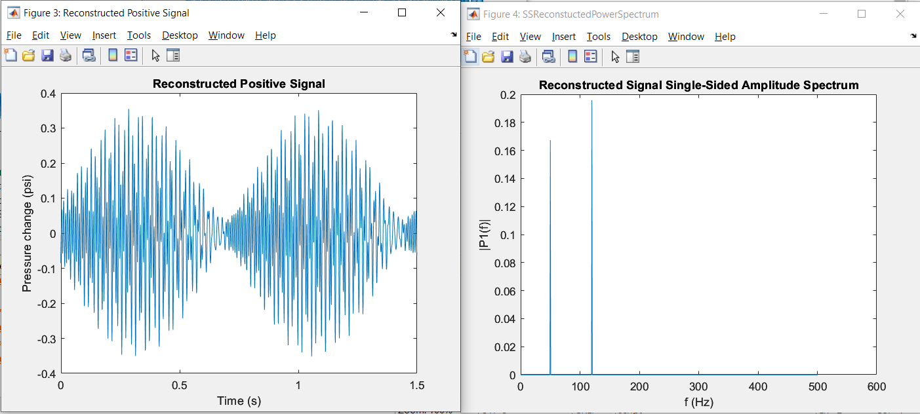
Beta Prototype - Data Processing Updates
Spectral analysis techniques were implemented
  Program was verified using a noisy sine wave
Specific wavelengths were reconstructed from the original power spectrum
All updates were committed to our git repository
  https://github.com/JettLanghorn/PlumeSurfaceInteractions.git

Slide 14
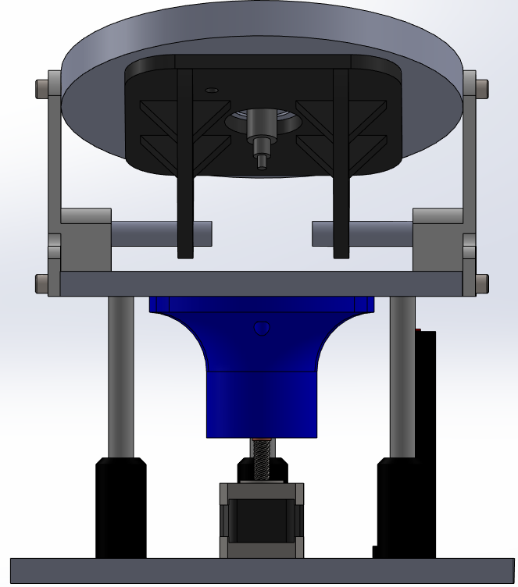
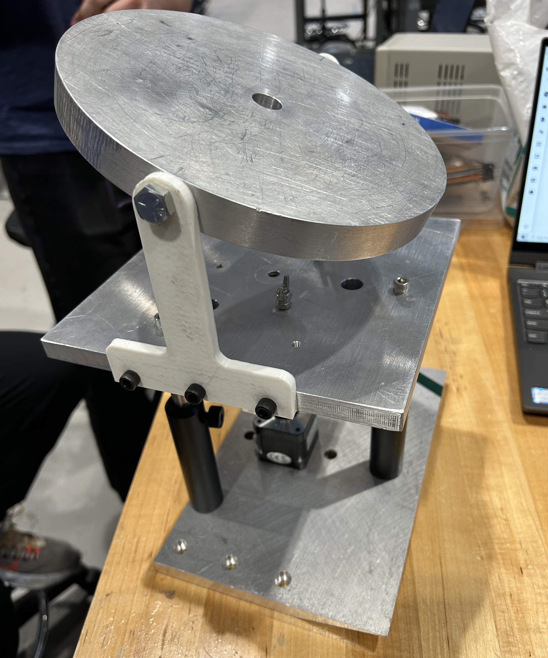
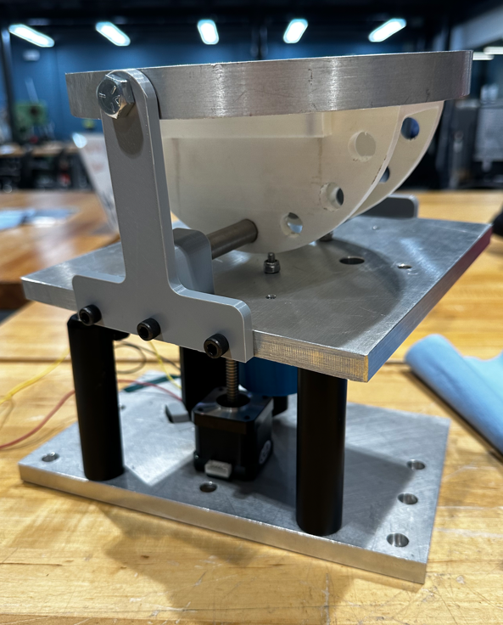
Beta Prototype Conclusion/Needs
Impingement plate can be fully secured at a particular orientation
Stepper motor/limit switch works and can actuate the plate up and down
  Something physical is inhibiting the motion
    Will check the 3d printed part, optical risers, hole alignment, etc
Sensor is capable of collecting data
We are capable of processing that data
Housing for arduino needs to be designed
Exact mounting orientation in tunnel

Slide 15
Timeline for Build/Testing
Part Fabrication/Assembly
February 20th - March 30th
  Machining, printing, test fitting - Completed
Electrical mounting/housing designed and manufactured by April 7th
Merging of Electrical Subsystems
March 30th - April 7th
  The solenoid and camera assembly need to be merged with rest of electrical assembly to allow everything to be controlled from Arduino
Ambient testing of full system
Immediately after final assembly
  Finalize experimental procedure
Full test
Early/Mid April
Subject to tunnel availability

Slide 16
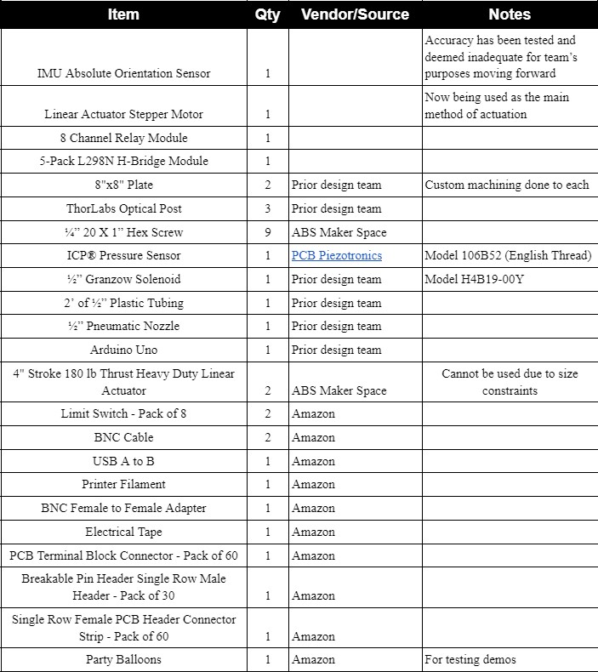
Bill of Materials for Beta Prototype

Slide 17
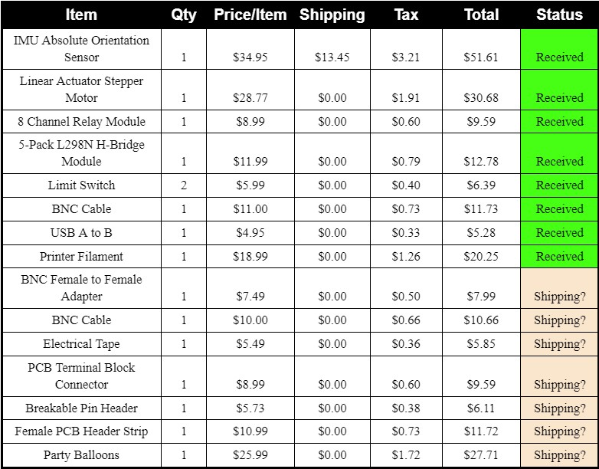

Budget

Slide 18
QUESTIONS?

